Slide 1

The tor project
Notes:
fix spaces

Slide 2
Agenda
Understand in full detail what is tor
Understand in full detail how tor works
This includes the protocol
This includes major components in its backend
Understand what are onion services(a.k.a the dark web)

Slide 3
Prerequisites
Basic networking knowledge(ip,ARP,NAT)
Basic understanding of encryption
Basic understanding of ssl/tls

Slide 4
Lets recap basic security concepts

Slide 5
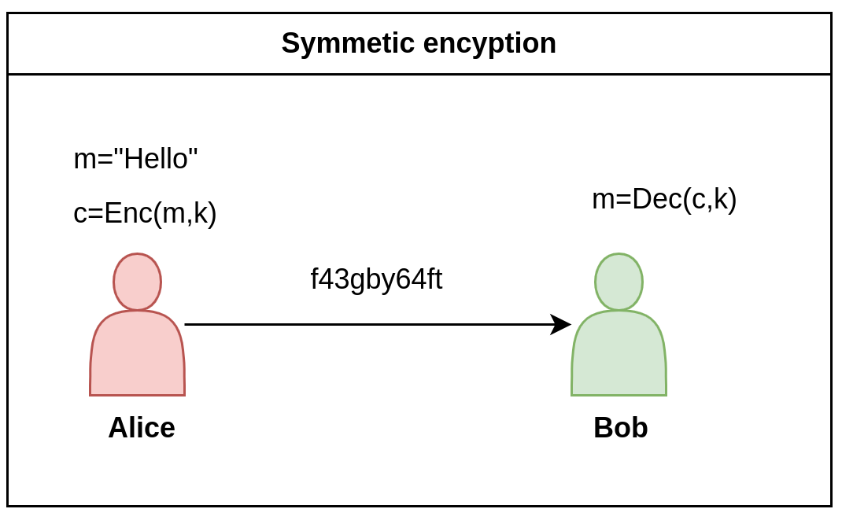
Symmetric encryption
There are 2 types of encryptions
Symmetric encryption:
Alice wants to send Bob a message m
Alice uses a special function Enc and a secret key k to create a ciphertext c
Bob uses the same secret key k and a special decrypt function DEC to retrieve the original message from the ciphertext

Slide 6
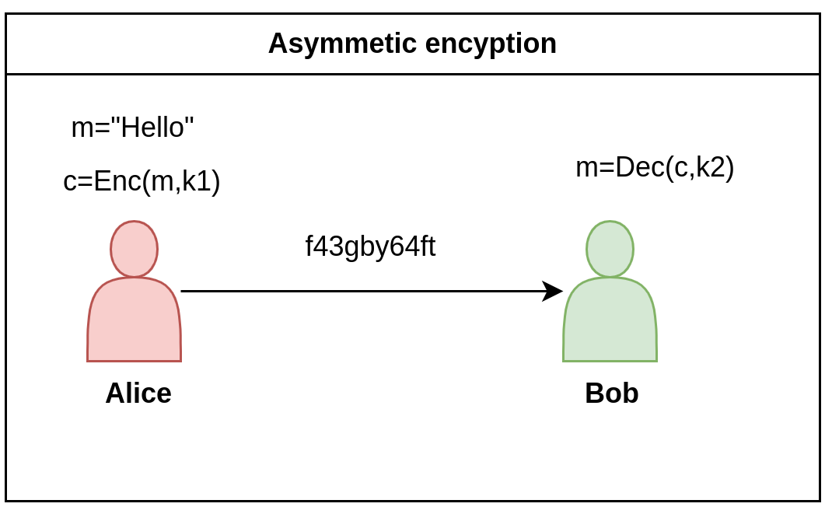
Asymmetric encryption
Asymmetric encryption:
Alice wants to send Bob a message m
Alice uses a special function Enc and a secret key k1 to create a ciphertext c
Bob uses the a different secret key k2 and a special decrypt function DEC to retrieve the original message from the ciphertext

Slide 7
Certificate authority
Establishing keys cannot be done in the open
A man in the middle can sniff all traffic,decrypt messages and fake keys
So some method to publish keys is required

Slide 8
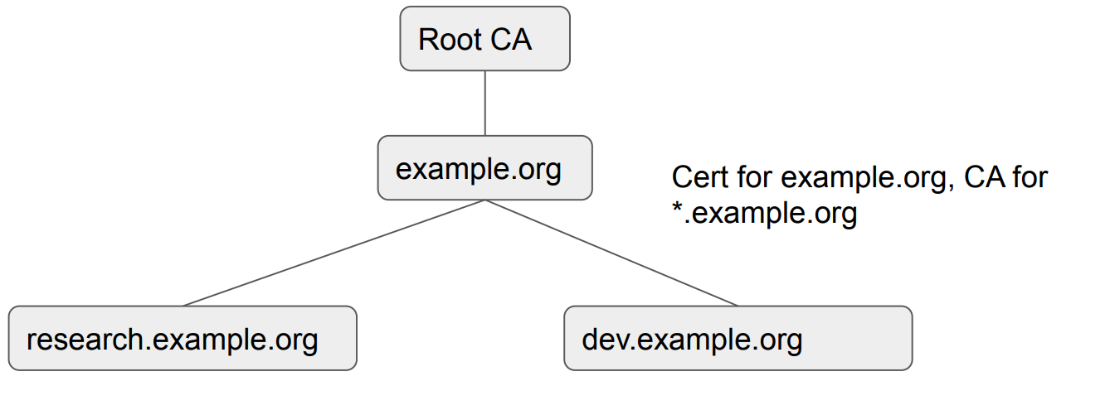
Certificate authority
We can establish a web of trust
I trust who my friends trust
My friends trust a CA
Every person must decide who is trust from different authorities

Slide 9
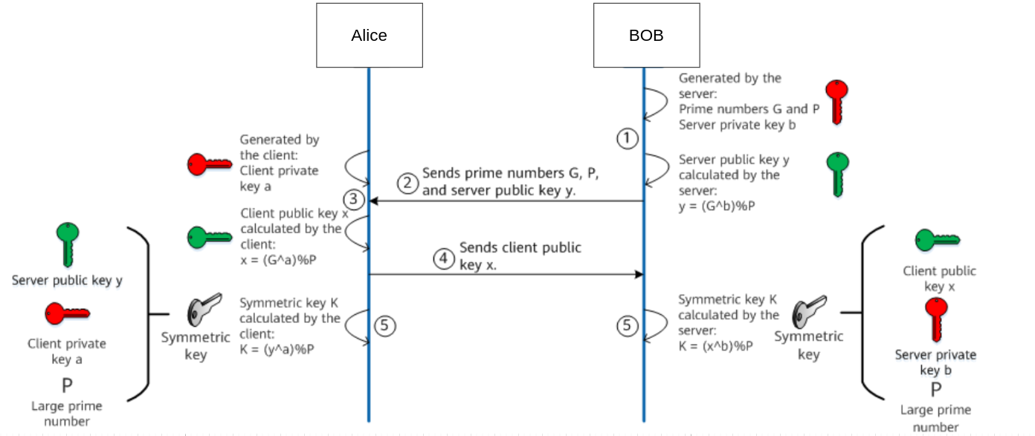
Diffie-Hellman key exchange
K=(y^a) % P=((G^b % P)^a) % P=(G^(a*b) % P)
K=(X^b) % P=((G^a % P)^b) % P=(G^(a*b) % P)
Notes:
also known as perfect forward encyption
write the computation better

Slide 10
What is TOR?

Slide 11
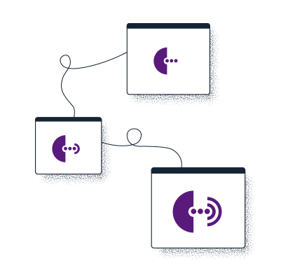
Different ways of defining Tor
Tor ⇒ free software created at NRL starting 2001/2.
Tor ⇒ an open network of ~9,500 nodes – anyone can join!
Tor ⇒ a browser that connects you to the Tor network.
Tor ⇒ a US non-profit formed in 2006.
Tor ⇒ a community of volunteers, researchers, developers, trainers, advocates from all over the world.

Slide 12
What is Tor?
Stands for The Onion Router
A way to use the internet with as much privacy as possible:
by routing traffic through multiple servers; and
by encrypting it each step of the way.
Hence the term “onion routing”.
Tor provides anonymity, mitigating against surveillance and censorship.
Notes:
https://matt.traudt.xyz/posts/2021-02-22-tor-spelling/ https://www.acsac.org/2011/program/keynotes/syverson.pdf

Slide 13
What is onion routing

Slide 14
Onion routing
A method for passing messages between client and server
A message is sent from client to server through intermediate stations
each intermediate node knows only its predecessor and successor
This makes tracing the message source very hard

Slide 15
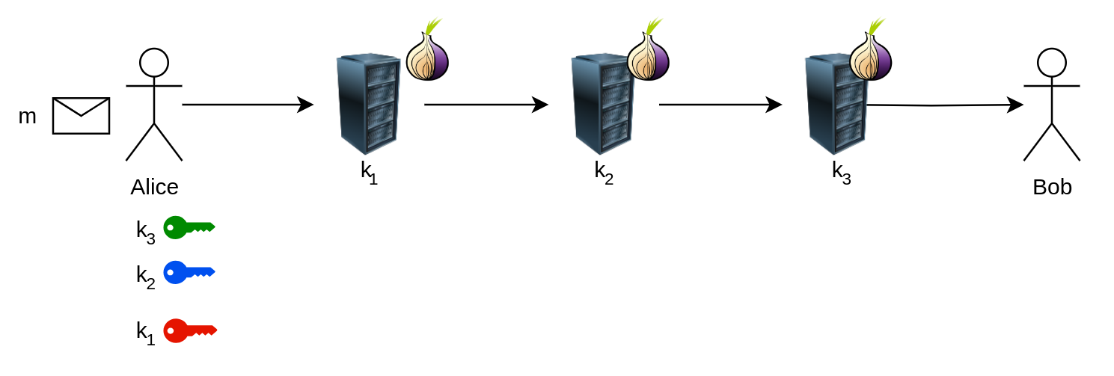
Onion routing

Slide 16
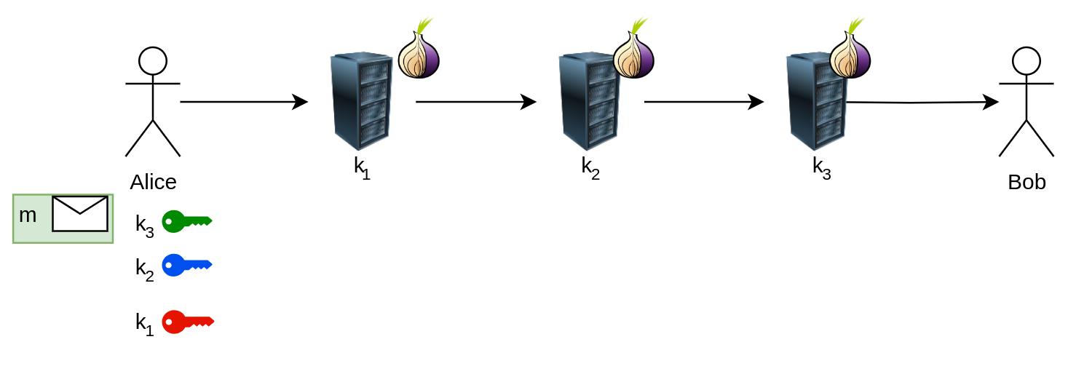
Onion routing

Slide 17
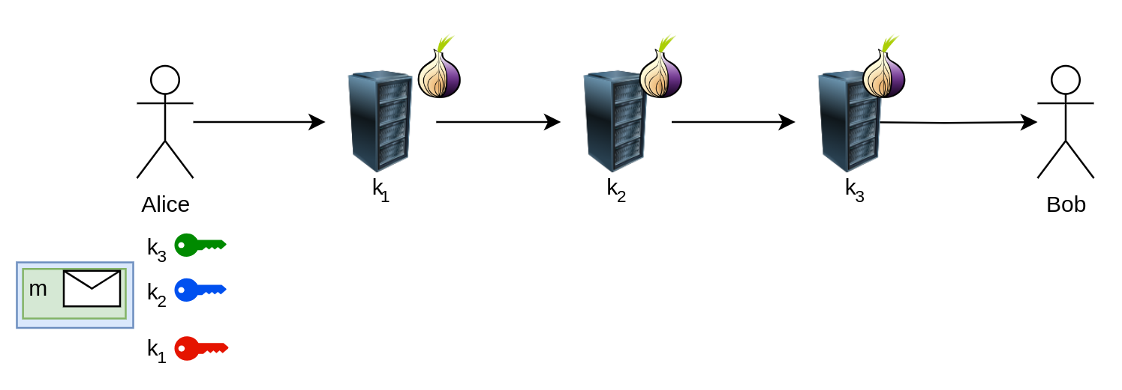
Onion routing

Slide 18
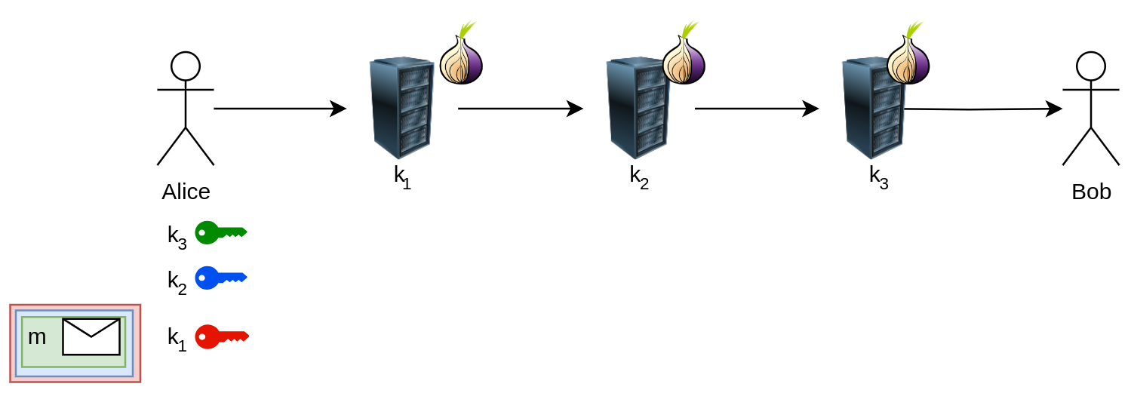
Onion routing

Slide 19
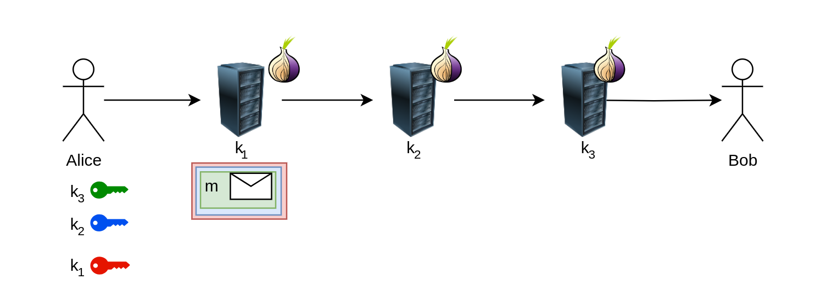
Onion routing

Slide 20
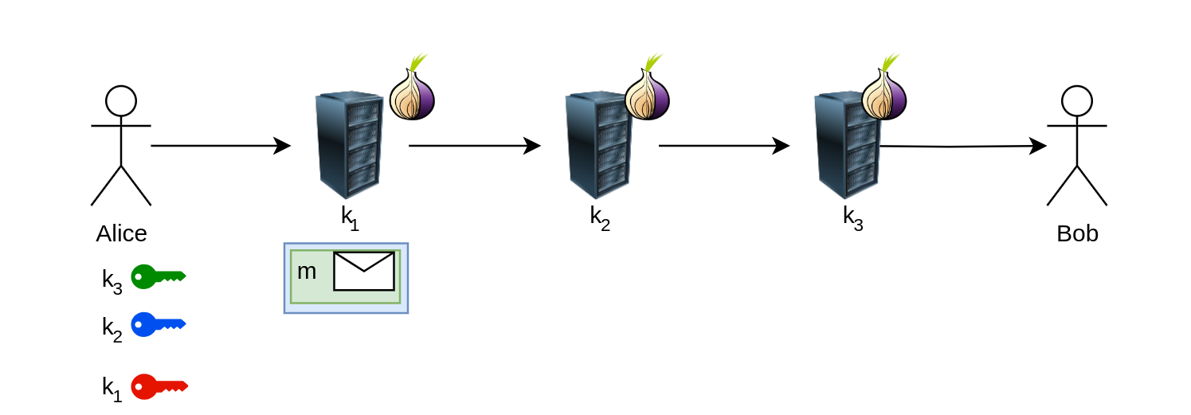
Onion routing

Slide 21
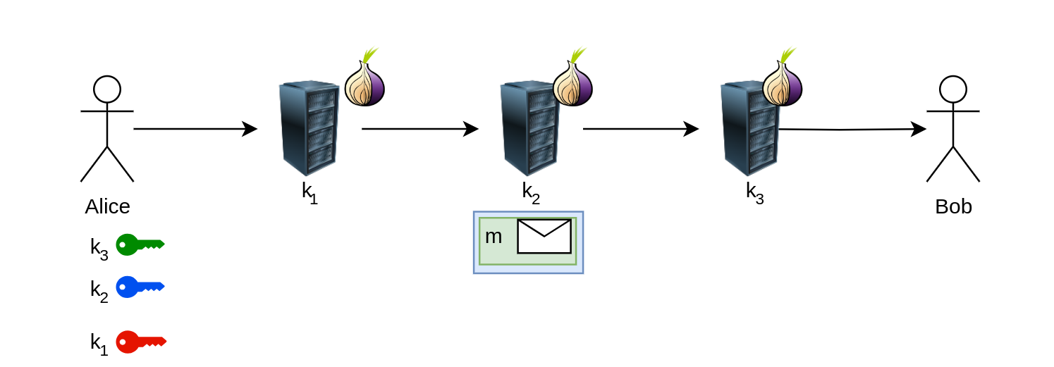
Onion routing

Slide 22
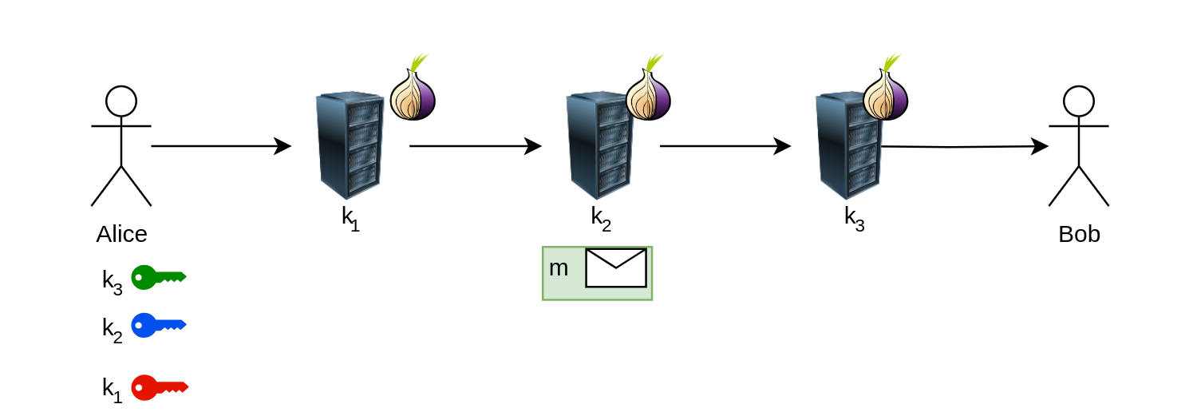
Onion routing

Slide 23
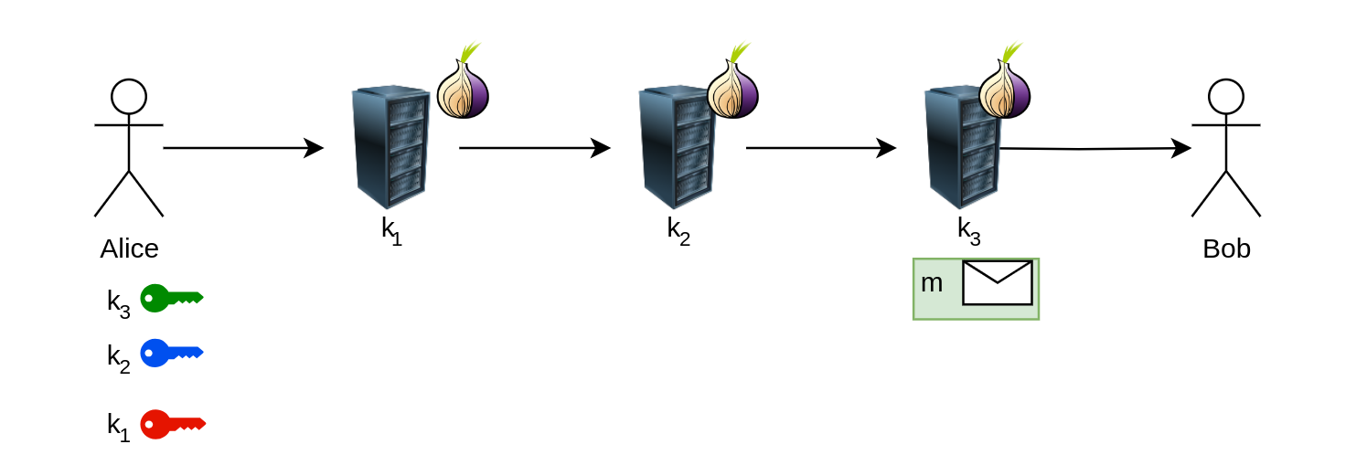
Onion routing

Slide 24
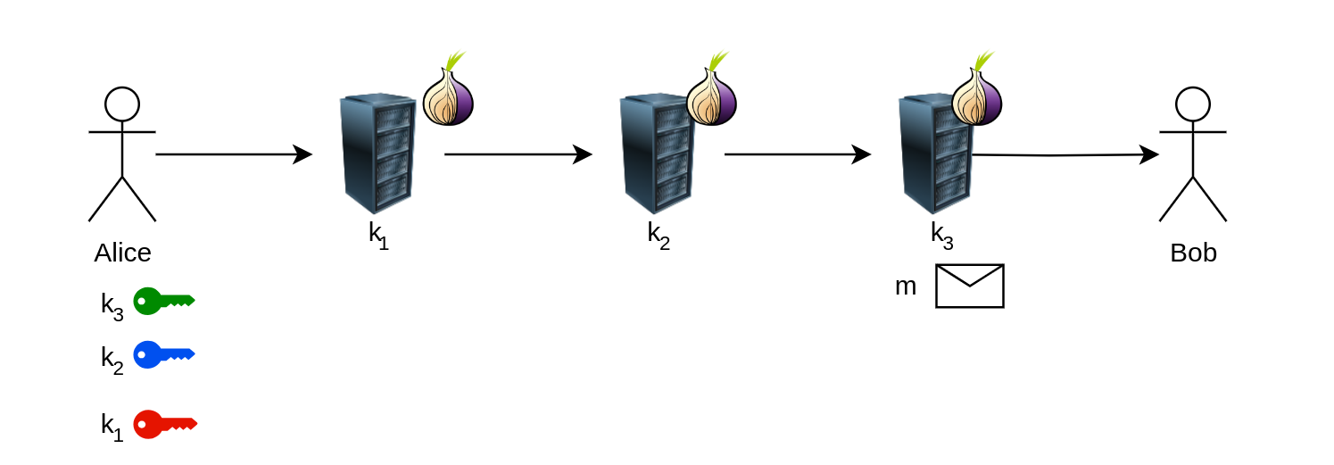
Onion routing

Slide 25
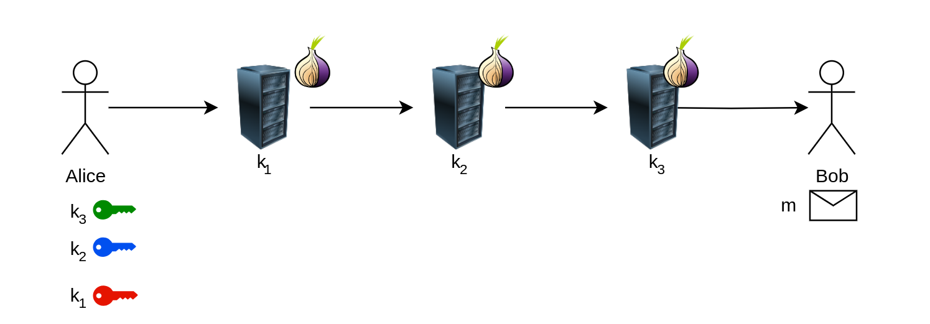
Onion routing

Slide 26
Onion routing

Slide 27
Onion routing

Slide 28
Onion routing

Slide 29
Onion routing

Slide 30
Onion routing

Slide 31
Onion routing

Slide 32
Onion routing

Slide 33
Onion routing

Slide 34
Onion routing

Slide 35
Onion routing

Slide 36
The TOR design

Slide 37
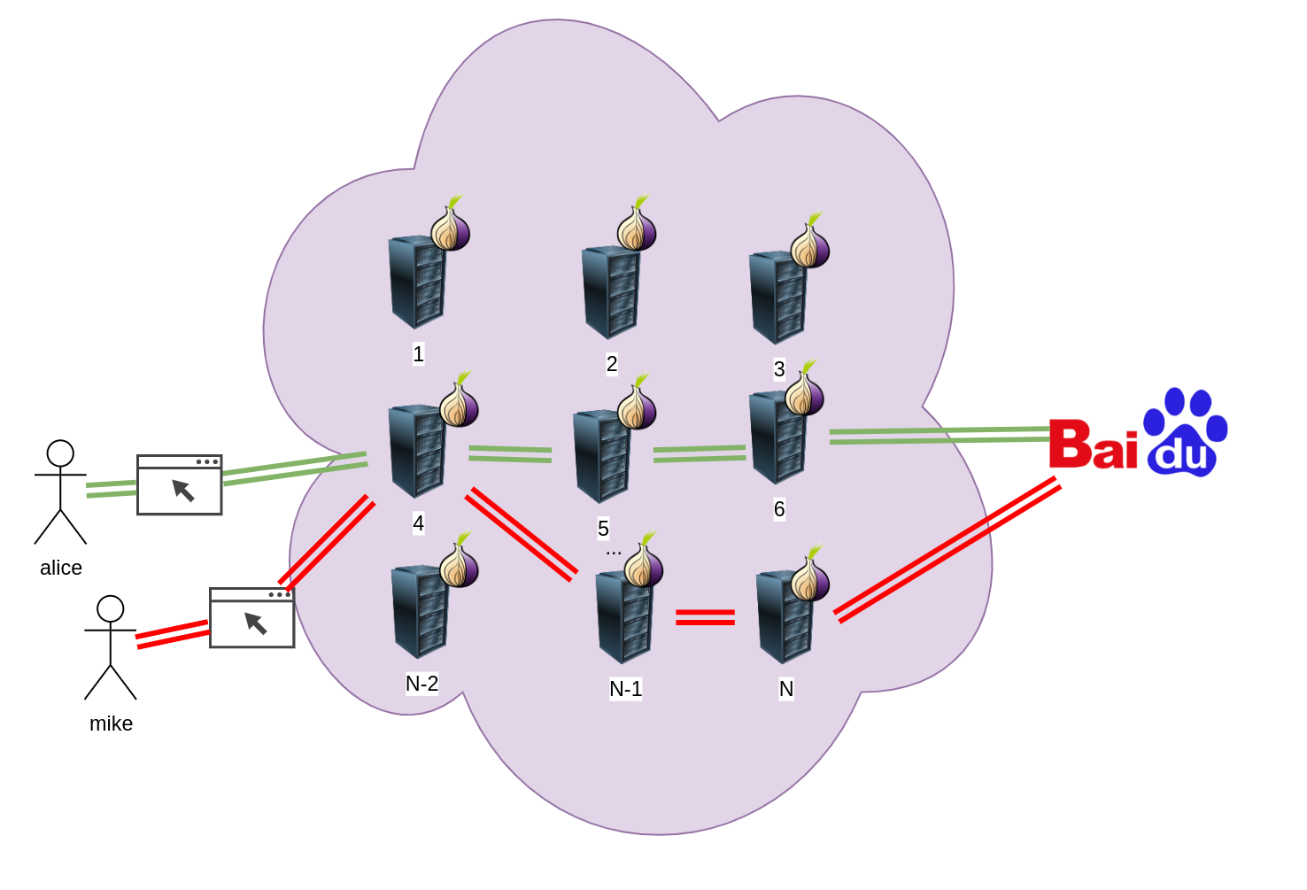
The TOR design
The TOR network is an overlay network comprised of nodes
Each node is called onion route
Nodes create a variation of onion routing paths called circuit
Traffic from a client is sent through a random circuit,comprised of random nodes to its destination
TOR assumes large numbers
Large number of nodes
Large number of client
As so very large amount of possible combinations
Notes:
Each onion router maintains a long term identity key and a short term onion key.
The length term key or the identity key is used for signing
The short term key or onion key is used for decrypting messages

Slide 38
CELLS and communication
Tor presents the SOCKS 5 proxy for communication
Tor provides communication only using tls\ssl
Currently runs only over TCP!!
Tor message are sent using a custom protocol
Messages are separated into 512 bytes and are called cells

Slide 39
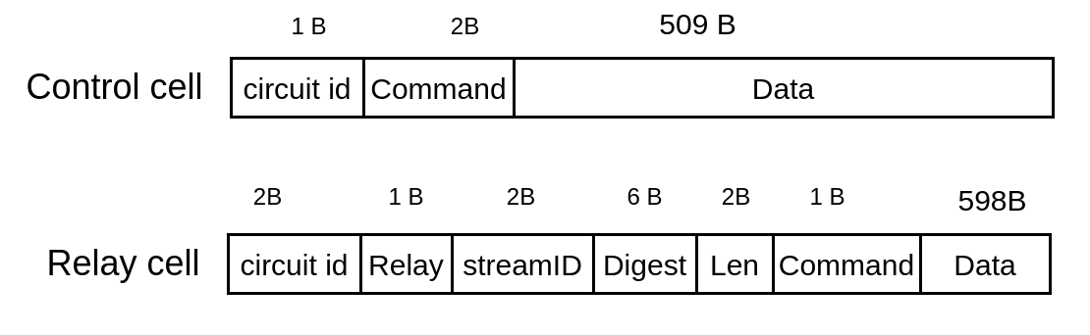
Cell types
There are 2 types of cells in TOR
The first type is called control cell and is used for sending control commands
The second type is called relay cell and it is used for sending data

Slide 40
Control cell
It is comprised of the following structure:
circuit id : 1 byte, uuid of the current circuit
Command : 2 Byte representing some control option.The options are:
padding : used for keep alive
create/created : used for creation of circuits
destroy : used for destroying a circuit
Data : 509 byte command content

Slide 41
Relay cell
It is comprised of the following structure:
circuit id : 1 byte, uuid of the current circuit
Relay : 1 Byte representing some control option.
StreamID : 2 Byte representing the stream byte. Multiple streams can be on a single circuit!
Digest : 6 Byte, checksum for integrity checking
Len : 2 Byte, the length of the relay payload

Slide 42
Relay cell
Command : 1 byte,a relay command.The options are:
relay data : for transferring data
relay begin : to open a stream
relay end : to close a stram
relay teardown : to destroy a stream
relay extend/relay extended :to ex- tend the circuit by a hop, and to acknowledge
relay truncate/relay truncated : to tear down only part of the circuit, and to acknowledge
relay sendme : congestion control
relay drop : implement long-range dummies

Slide 43
Relay cell
data : 598B for command data

Slide 44
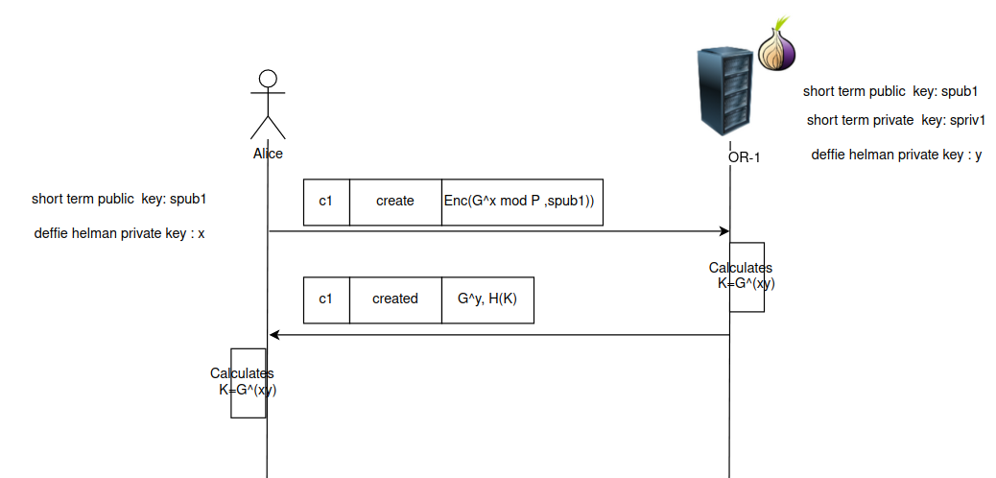
Circuit creation
data : 598B for command data

Slide 45
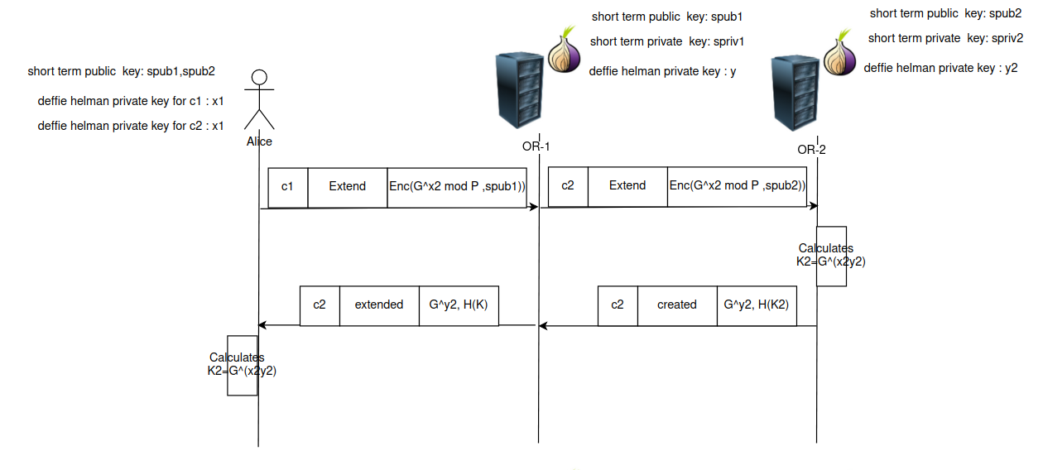
Circuit creation
data : 598B for command data

Slide 46
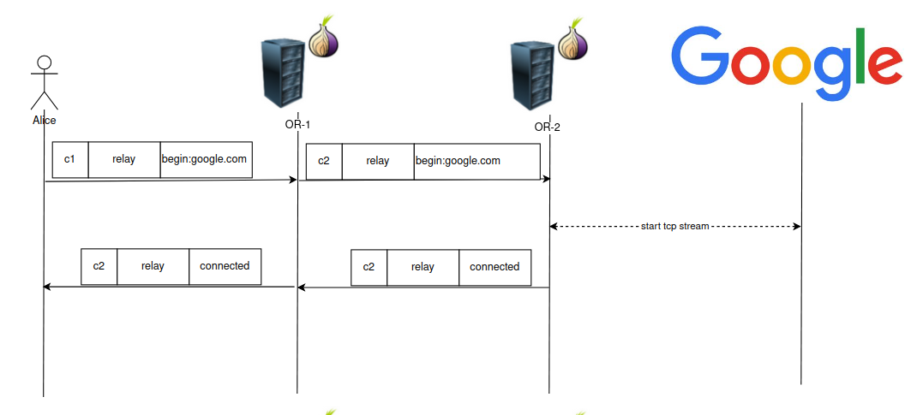
Circuit creation
data : 598B for command data

Slide 47
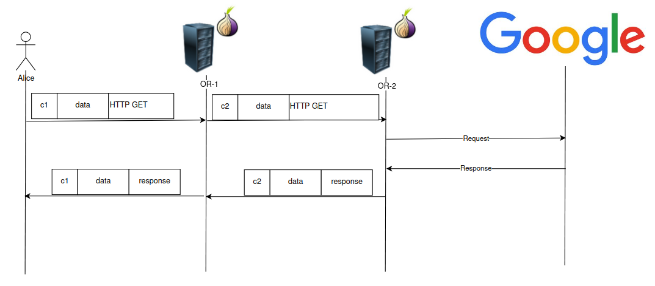
Circuit creation
data : 598B for command data

Slide 48
Types of nodes
There are couple types of nodes in a TOR:
Guard node:the entry node
Relay node : general term for node in a circuit
Exit node : the exit
Introduction nodes: Connects to the dark web
Redenzous nodes: Connection point to the hidden service
Authority node : a list of hard coded nodes which contain the data on all nodes in the network in a consensus file.They are trusted
Hidden directory node : holds information about nodes in the network
Bridge nodes : not publicly registered nodes in the tor network.

Slide 49
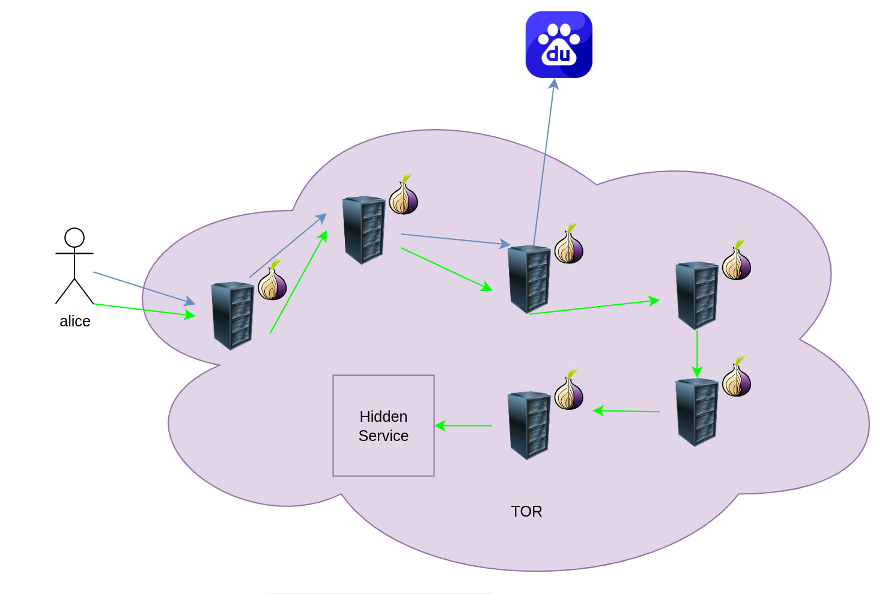
TOR Hidden services aka “The dark web”
relay
Rendezvous point
relay
guard
guard
relay

Slide 50
TOR Hidden services aka “The dark web”
A famous component of TOR is the dark web where illegal stuff are done
Unlike regular TOR where traffic goes in to TOR and exists to the regular internet,the traffic does not leave thee TOR network
Traffic remaining in the dark web cannot be easily discovered.
Unlike regular circuit there are 6 nodes in a connection to a “hidden service”
Alice<->Guard<->Relay<->Rendezvous point<->Relay<->Relay<->Guard<->Hidden service

Slide 51
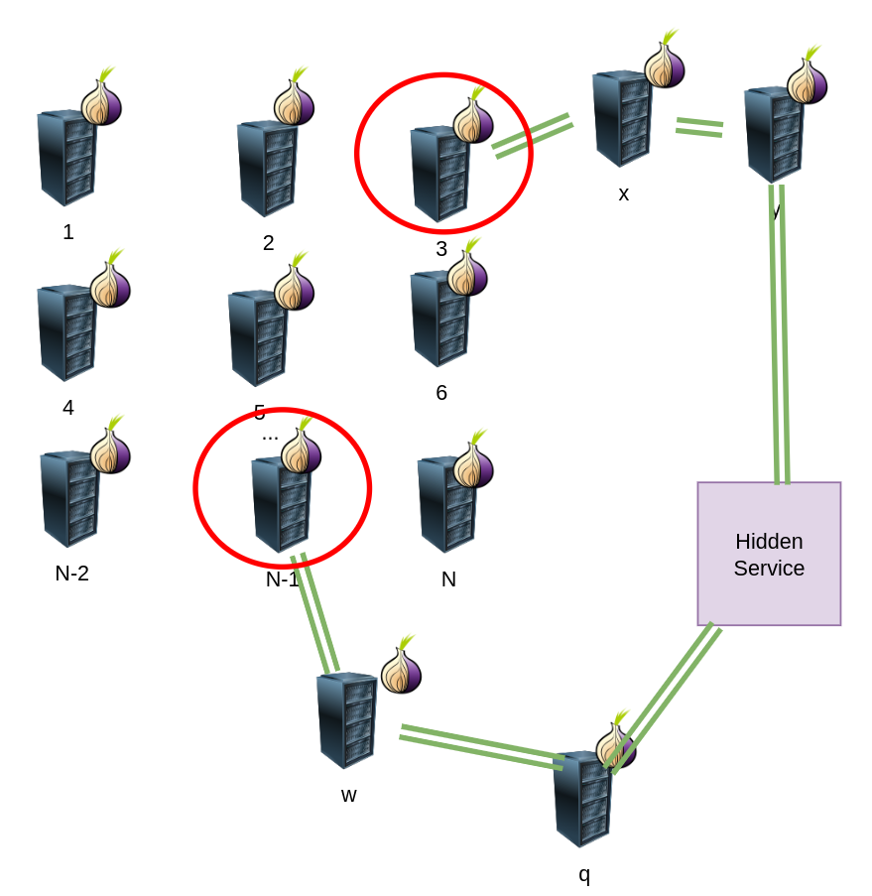
TOR Hidden services aka “The dark web”
A hidden service creates circuits to a list of random relay nodes in the node circuits
Each node in this list is known as “introduction point”
Each “introduction point” does not know that it an introduction point
The list of introduction points is then sent to the directory authority

Slide 52
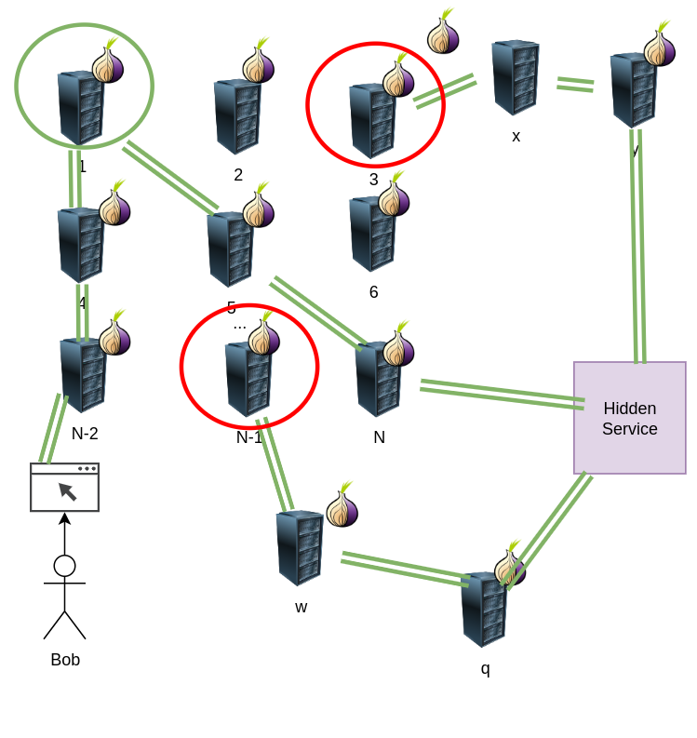
TOR Hidden services aka “The dark web”
A client wishing to connect to the hidden service queries the directory authority for a introduction point
It creates a circuit known as introduction point ,sends details to random introduction point
The hidden service then creates a circuit to the introduction point and then connects to the hidden service

Slide 53
TOR onion address
Look different to regular website address
Tor onion services are for hidden services only
Onion services end with `.onion`
Onion addresses have the following format:
Base32(public long term key| checksum of key | protocol version)
Site | Address
Facebook | https://www.facebookwkhpilnemxj7asaniu7vnjjbiltxjqhye3mhbshg7kx5tfyd.onion/
bbc | https://www.bbcnewsd73hkzno2ini43t4gblxvycyac5aw4gnv7t2rccijh7745uqd.onion/
nytimes | https://ej3kv4ebuugcmuwxctx5ic7zxh73rnxt42soi3tdneu2c2em55thufqd.onion/

Slide 54
TOR descriptor
A document that specifies information about a hidden service
This includes a list of all introduction points
This includes other parameters such as requirements for authentications
The descriptor is published and is saved inside the HSDIR database

Slide 55
HSDir
Short for hidden service director server
This is a distributed hash table database that keeps hidden service descriptors( a list of introduction points for hidden service)
Client queries the table and can receive the descriptor

Slide 56
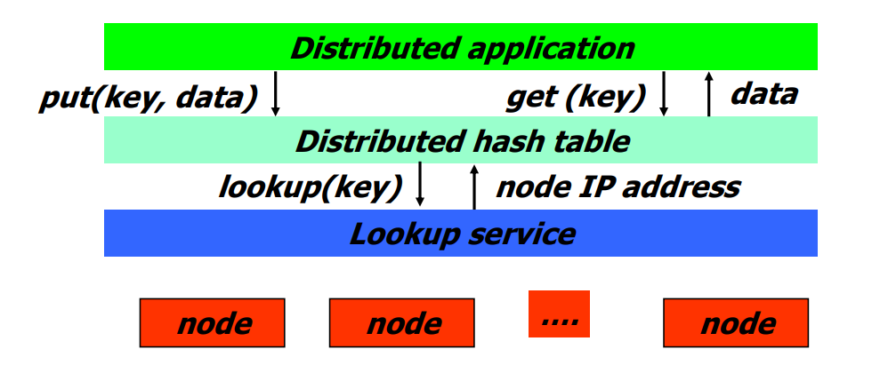
Theory: Distributed Hash Table
Also sometimes known as key value store
A type of distributed system that provides lookup services
DHT may be distributed over many nodes(scalable)
DHT are fault tolerant
DHT do not have a central authority
Supports put/get/delete/update API
Does not impose any structure on keys

Slide 57
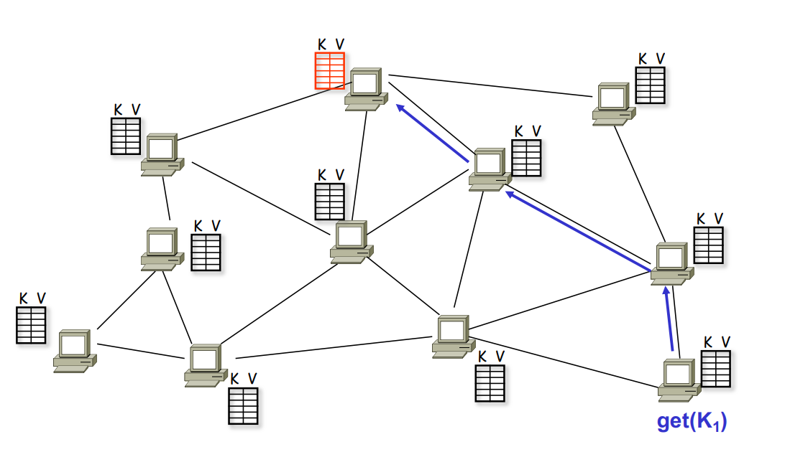
Theory: Distributed Hash Table
put(k1,v1)

Slide 58
Theory: Distributed Hash Table
The most popular DHT algorithms are Kademlia,Chord and Pasttry
Most distributed DHT have an imaginary namespace geography:
Keys are mapped into some abstract geographic space
Routing is done by “closeness”

Slide 59
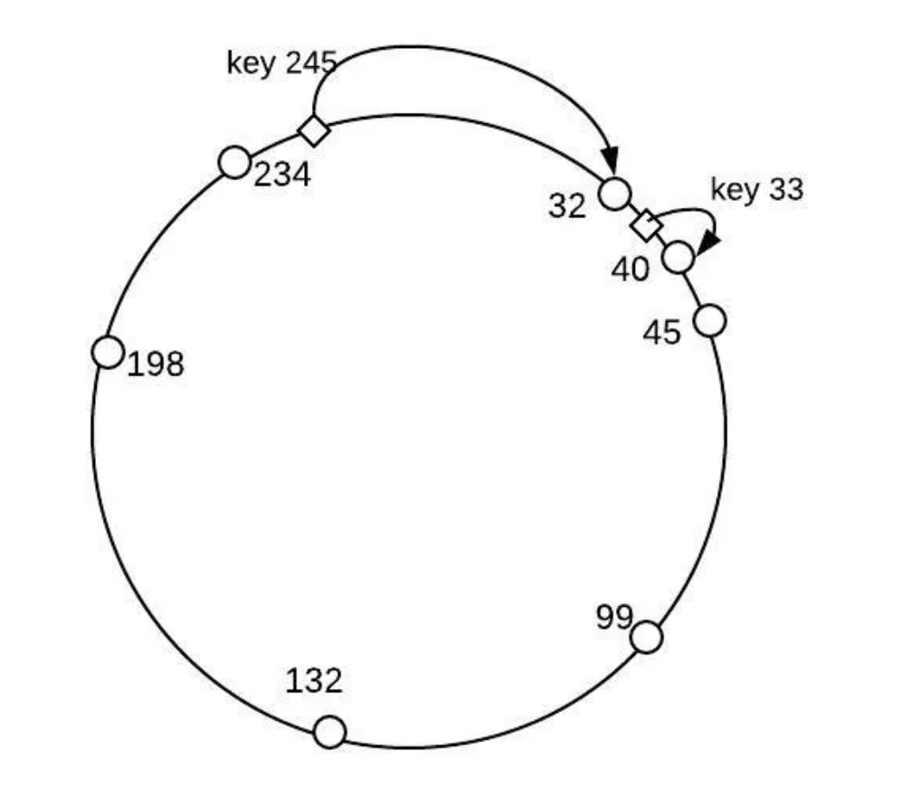
Theory: Distributed Hash Table
Lets look for example at the Chord algorithm
Each node has n-bit ID
ID space is circular
Date keys are also IDs
Key is stored on next higher nod
Consistent hashing
Easy to find keys slowly by following chain of successors

Slide 60
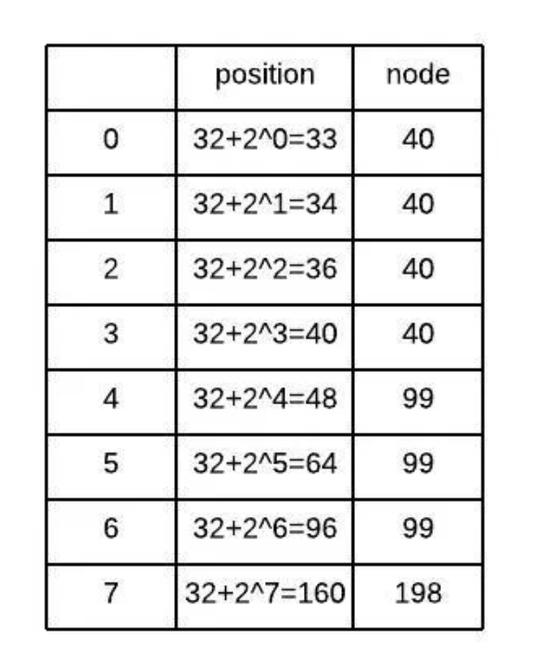
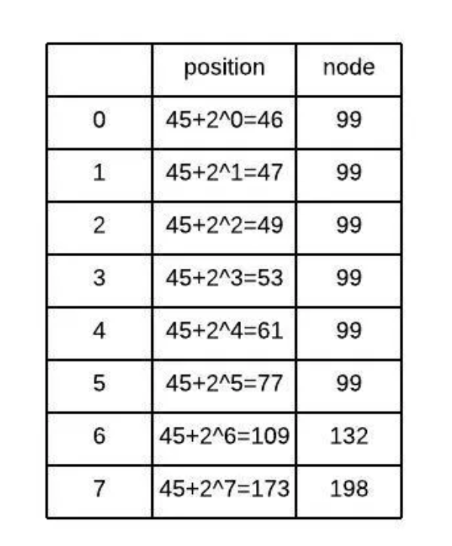
Theory: Distributed Hash Table
The naive method has linear search time
Chord improves it by holding a small “finger” table of size n
Run time to find entry becomes O(log (# of nodes))
Each entry i for node m holds the closest node by formula:
m+2^(i-1) mod 2^n
32
45

Slide 61
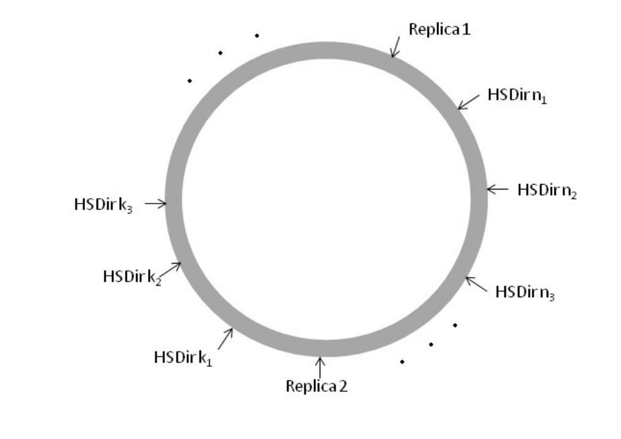
TOR DHT
Tor uses a distributed hash table with a circular DHT space
The space size is n=256
The DHT space changes every 24 hours

Slide 62
Onion service creation and publication
To publish an onion service descriptor the onion service the
service must find the responsible hsdir
The index of HSDir on the DHT can be found by :
Index=Hash(“node-idx”|pub_{id}|S|N_{p}|T)
pub_{id}= public key of the known hsdir
S = shared random value
N_{p}= number of time period
T = default time period

Slide 63
Onion service creation and publication
Then the hidden service calculates the indices of its description
The indices of the descriptors are calculated by:
for r in 1…R:
Index=Hash(“store-at-idx”|pub_{b}|r|T|N_{p})
R=2
pub_{b}= blinded public key
r = number of dir
T = default time period
N_{p}= number of time period

Slide 64
Onion service creation and publication
After performing the calculation the onion service selects 4 HSDIRS on the DHT as the responsible dirs
Notice that 2 replicase are selected
The service then uploads the descriptor to the responsible table
The blinded key is used as table index for the descriptor

Slide 65

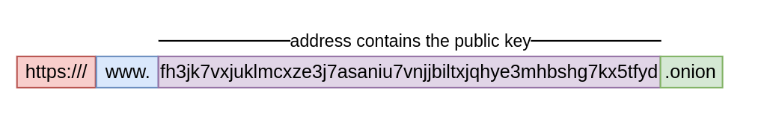
how access to hidden service is done?
Step 1 : The user discovers the onion address in some way
The address contains the public key of the website
Notes:
A client finds out the onion address in some way
The client enters the address in the browser
The address contains the public key of the website
The browser extracts the long term public key and computs the blinded public key
The browser then computes the DHT and requests the descriptor from the HSDIR using the blinded key
Using the descriptor the client selects a node as redenzours point
The client creates a circuit at the redenzeous point
The client creates a special cookie for identification
It sends the cookie with details about the redenzeous point to the introduction point
Now we have a connection to the hidden service

Slide 66
how access to hidden service is done?
Step 2: The user enters the address in the browser
The browser extracts the public key and computes the blinded public key
The browser then computes the DHT using S and T
Notes:
A client finds out the onion address in some way
The client enters the address in the browser
The address contains the public key of the website
The browser extracts the long term public key and computs the blinded public key
The browser then computes the DHT and requests the descriptor from the HSDIR using the blinded key
Using the descriptor the client selects a node as redenzours point
The client creates a circuit at the redenzeous point
The client creates a special cookie for identification
It sends the cookie with details about the redenzeous point to the introduction point
Now we have a connection to the hidden service

Slide 67
how access to hidden service is done?
Step 3: The browsers finds out the introduction points
The browser requests the descriptor from the HSDIR using the blinded key as index
The browser then extracts from the descriptor the introduction point
Notes:
A client finds out the onion address in some way
The client enters the address in the browser
The address contains the public key of the website
The browser extracts the long term public key and computs the blinded public key
The browser then computes the DHT and requests the descriptor from the HSDIR using the blinded key
Using the descriptor the client selects a node as redenzours point
The client creates a circuit at the redenzeous point
The client creates a special cookie for identification
It sends the cookie with details about the redenzeous point to the introduction point
Now we have a connection to the hidden service

Slide 68
how access to hidden service is done?
Step 4: The browsers creates a rendezvous point
It chooses the node at random
Step 5 : The browser generates a special cookie with details about the rendezvous point
Step 6: The browser sends a request to the introduction point
Step 7: a circuit is created to the hidden service
Notes:
A client finds out the onion address in some way
The client enters the address in the browser
The address contains the public key of the website
The browser extracts the long term public key and computs the blinded public key
The browser then computes the DHT and requests the descriptor from the HSDIR using the blinded key
Using the descriptor the client selects a node as redenzours point
The client creates a circuit at the redenzeous point
The client creates a special cookie for identification
It sends the cookie with details about the redenzeous point to the introduction point
Now we have a connection to the hidden service

Slide 69
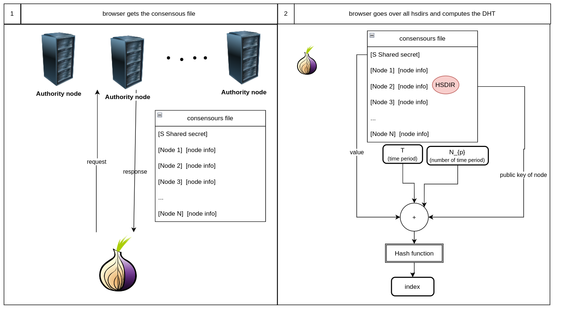
Process summary

Slide 70
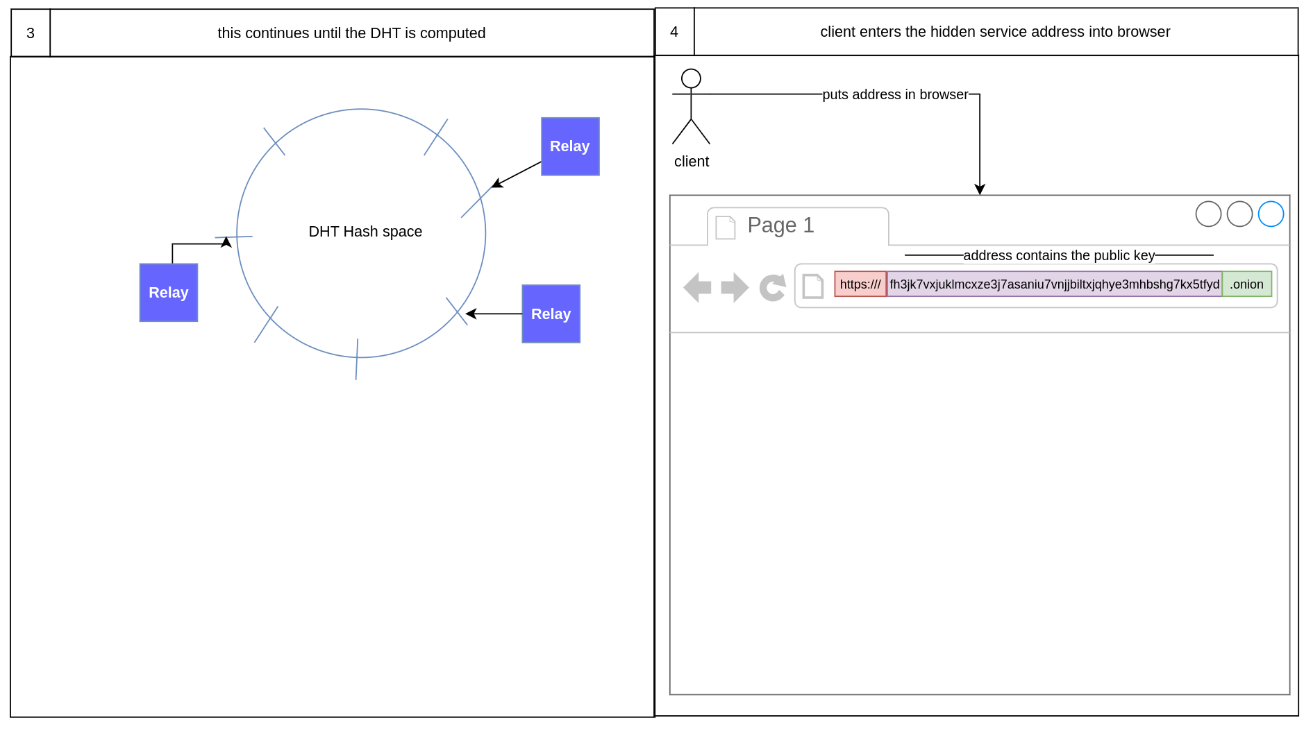
Process summary

Slide 71
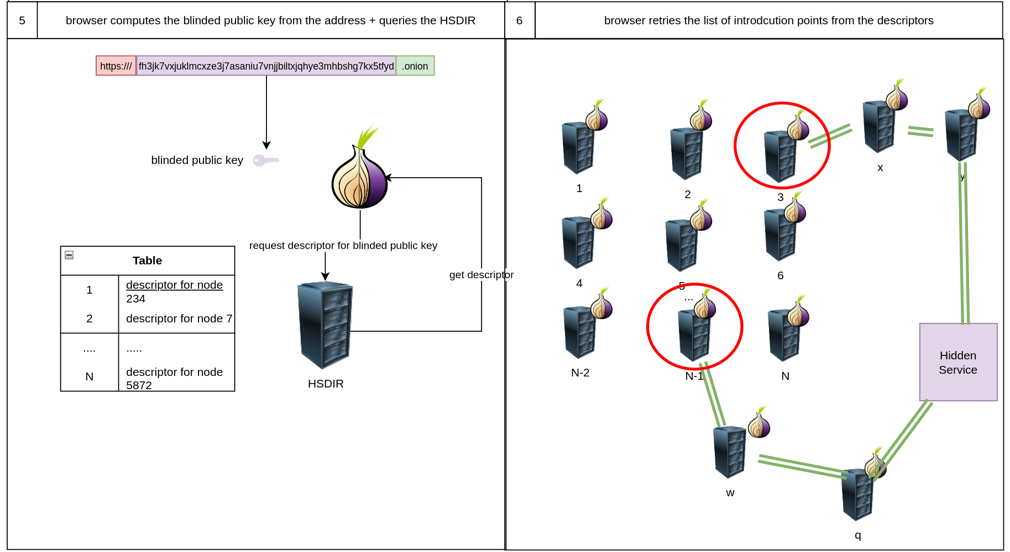
Process summary

Slide 72
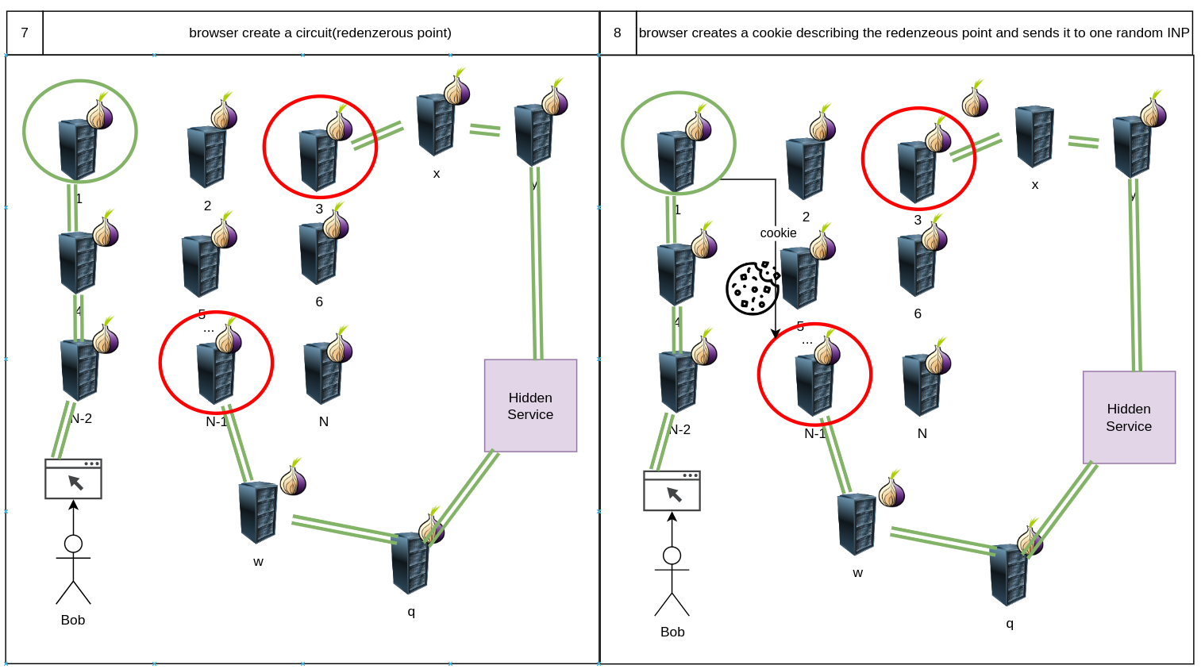
Process summary

Slide 73
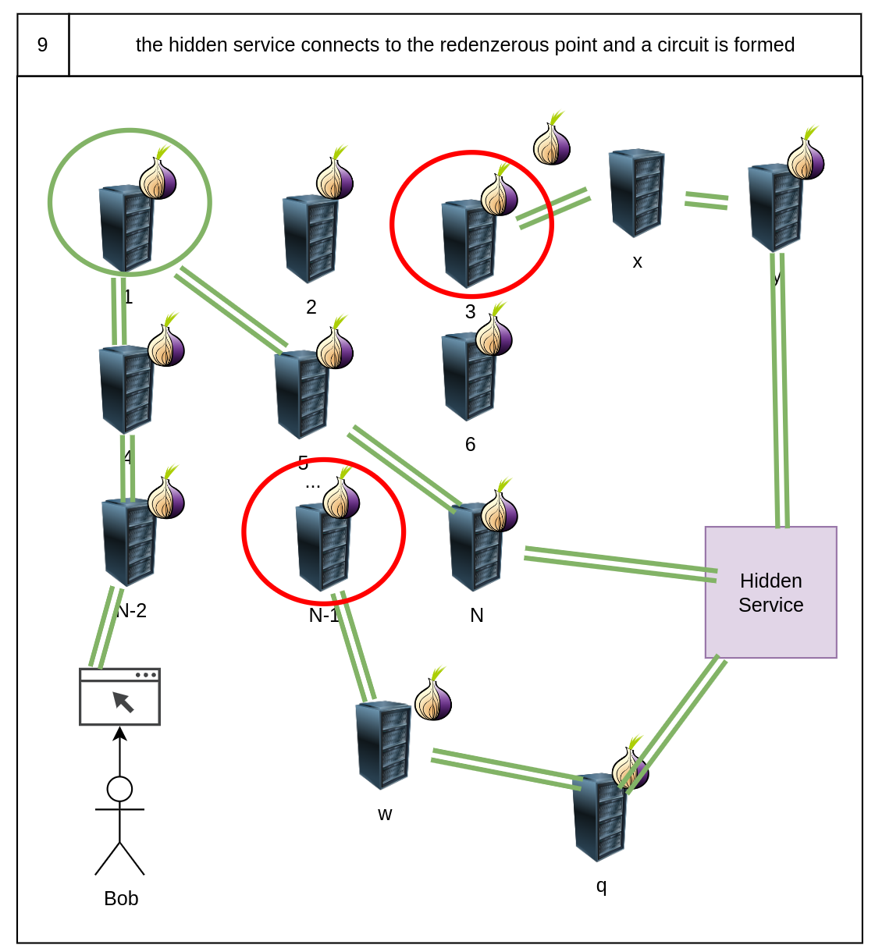
Process summary

Slide 74
TOR problems

Slide 75
Known Tor design problems
Although TOR is better then regular Internet it is still contains some known problems
If an attack controls all three nodes she can identify the user
If an attack controls both guard and exit node she can with high probability deanonymize the user
“Traffic correlation attack”
Works regardless of circuit length
Can be used by a powerful adversary who can observe large number tor nodes
Notes:
A client finds out the onion address in some way
The client enters the address in the browser
The address contains the public key of the website
The browser extracts the long term public key and computs the blinded public key
The browser then computes the DHT and requests the descriptor from the HSDIR using the blinded key
Using the descriptor the client selects a node as redenzours point
The client creates a circuit at the redenzeous point
The client creates a special cookie for identification
It sends the cookie with details about the redenzeous point to the introduction point
Now we have a connection to the hidden service

Slide 76
Known Deanonymization techniques
Also Tor is vulnerable in implementation level
SOCKS5 might leak DNS requests and reveal your identity
/server-status attack
hidden service certificate might listed on regular internet
Downgrade HTTP protocol attack
SSL heartbleed attack
Notes:
A client finds out the onion address in some way
The client enters the address in the browser
The address contains the public key of the website
The browser extracts the long term public key and computs the blinded public key
The browser then computes the DHT and requests the descriptor from the HSDIR using the blinded key
Using the descriptor the client selects a node as redenzours point
The client creates a circuit at the redenzeous point
The client creates a special cookie for identification
It sends the cookie with details about the redenzeous point to the introduction point
Now we have a connection to the hidden service

Slide 77
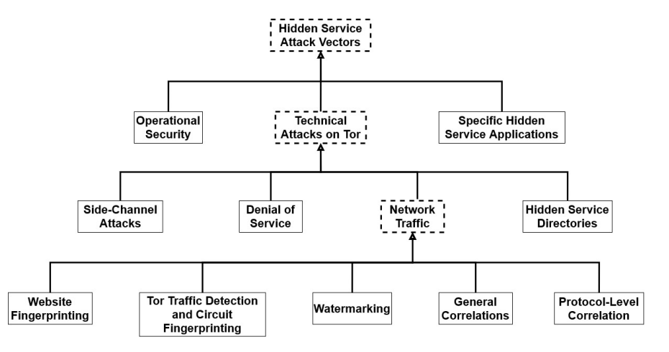
Classification of attack vectors
Notes:
A client finds out the onion address in some way
The client enters the address in the browser
The address contains the public key of the website
The browser extracts the long term public key and computs the blinded public key
The browser then computes the DHT and requests the descriptor from the HSDIR using the blinded key
Using the descriptor the client selects a node as redenzours point
The client creates a circuit at the redenzeous point
The client creates a special cookie for identification
It sends the cookie with details about the redenzeous point to the introduction point
Now we have a connection to the hidden service

Slide 78
Honorable mentions

Slide 79
Honorable mentions
There are couple of interesting topics in TOR which were not covered
OnionBalance
Bridges
Proof of work, rate limiting and digital signatures mechanisms for anti ddos protection
Vanguards
Pluggable Transports
How to actually use TOR
How to use TOR and remain anonymous
Famous sites in the dark web
Notes:
A client finds out the onion address in some way
The client enters the address in the browser
The address contains the public key of the website
The browser extracts the long term public key and computs the blinded public key
The browser then computes the DHT and requests the descriptor from the HSDIR using the blinded key
Using the descriptor the client selects a node as redenzours point
The client creates a circuit at the redenzeous point
The client creates a special cookie for identification
It sends the cookie with details about the redenzeous point to the introduction point
Now we have a connection to the hidden service

Slide 80
Resources
See attached links
Notes:
A client finds out the onion address in some way
The client enters the address in the browser
The address contains the public key of the website
The browser extracts the long term public key and computs the blinded public key
The browser then computes the DHT and requests the descriptor from the HSDIR using the blinded key
Using the descriptor the client selects a node as redenzours point
The client creates a circuit at the redenzeous point
The client creates a special cookie for identification
It sends the cookie with details about the redenzeous point to the introduction point
Now we have a connection to the hidden service

Slide 81
Thank you!

Slide 82
Bonus: podcasts about TOR

Slide 83
Podcast
Podcast name | episode | Description | Link
Darknet dairies | 131: welcome to video | The largest minor sex trafficking website | https://open.spotify.com/episode/5MHPoDQKo59beLkISWDscT?si=sGUGLe2GRy6C4pB028ztDw
Darknet dairies | 104: arya | This episode focuses on the life of a young man who used Tor to access darknet marketplaces and purchase drugs. It provides a personal perspective on the risks and allure of navigating the darknet through Tor. | https://open.spotify.com/episode/3bapFgoW8rrq2YftGN5aHj
Darknet dairies | 24: operation bayonet | This episode delves into the takedown of AlphaBay, a major darknet marketplace. It sheds light on how Tor is used by darknet vendors and marketplaces to mask their identities and locations. | https://open.spotify.com/episode/4sMVVjgOfN4DixQkk3pUcu
Notes:
A client finds out the onion address in some way
The client enters the address in the browser
The address contains the public key of the website
The browser extracts the long term public key and computs the blinded public key
The browser then computes the DHT and requests the descriptor from the HSDIR using the blinded key
Using the descriptor the client selects a node as redenzours point
The client creates a circuit at the redenzeous point
The client creates a special cookie for identification
It sends the cookie with details about the redenzeous point to the introduction point
Now we have a connection to the hidden service

Slide 84
Bonus: About Tor Browser

Slide 85

What is Tor Browser?
Just like any other browser (Chrome, Firefox, Safari, Yandex) except it does not expose traffic.
Traffic is encrypted and bounces through three random volunteer-run nodes called relays.

Slide 86
What is Tor Browser?
Tor Browser = little-t tor + patched Firefox
Anyone snooping can’t see the websites you visit.
Websites can’t track you or see other sites you visit (cross-tracking).
Prevents other privacy violations like fingerprinting or third-party cookies.
Writes nearly nothing to disk.
No browser history.
Cross platform: Windows, macOS, Linux and Android.

Slide 87
Multilingual Browser
Tor Browser is available in 37 languages in a single multi-locale download, which can be changed using the menu in General settings: https://www.torproject.org/download/languages/
Tor Browser manual is a user-friendly guide for novice users and is also multilingual: https://tb-manual.torproject.org/

Slide 88

Downloading Tor Browser
The safest way to download is from: https://torproject.org
Downloading Tor Browser from a non-official source is dangerous!
If https://torproject.org is blocked, try mirrors
https://tor.eff.org/
http://tor.calyxinstitute.org/ (if HTTPS is blocked)

Slide 89
Bypassing censorship of torproject.org
Tor Project website and mirrors could be blocked on your network making it more difficult to download Tor Browser.
Alternative
Emailing GetTor to receive links to download Tor browser: gettor@torproject.org (from a Gmail or Riseup email)
Messaging @GetTor on Telegram: https://t.me/gettor_bot

Slide 90
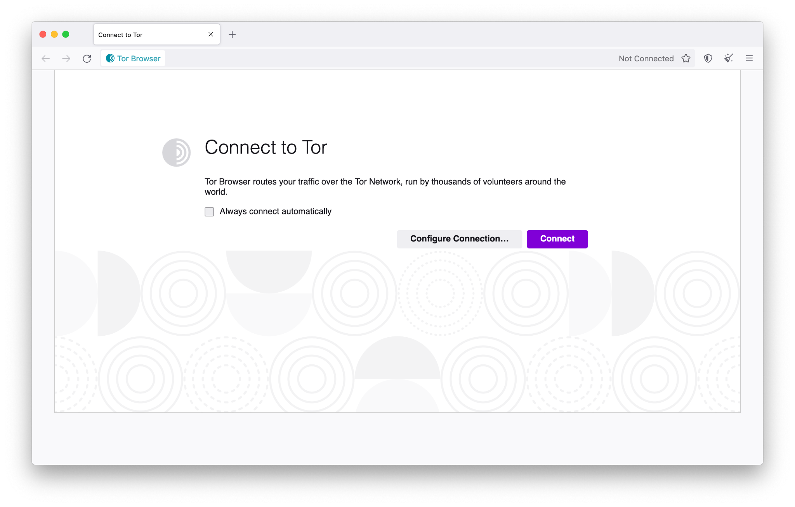
Running Tor Browser for the first time

Slide 91
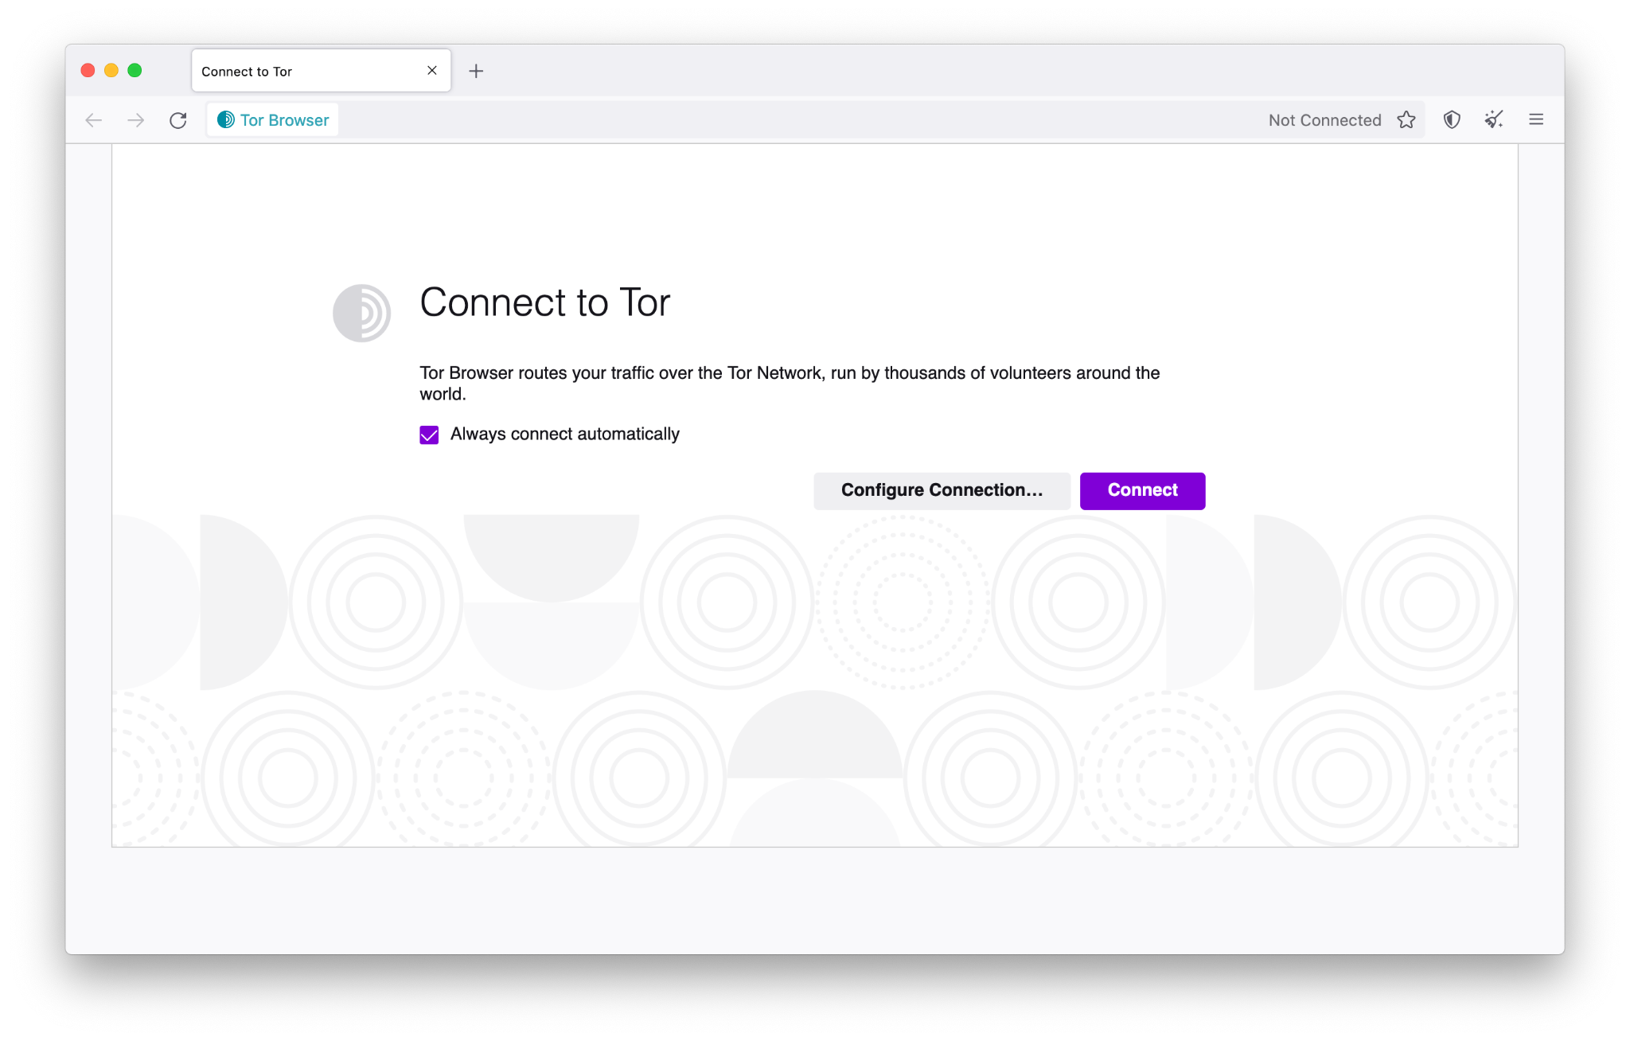
Choose to connect to Tor automatically

Slide 92
Using Tor Browser
Default search engine: DuckDuckGo
Bundled with privacy-preserving extensions such as NoScript.
You should not add any other extensions nor enable any plugins!
Advice: websites won’t know anything about you unless you login and tell them (e.g. logging into Facebook).

Slide 93
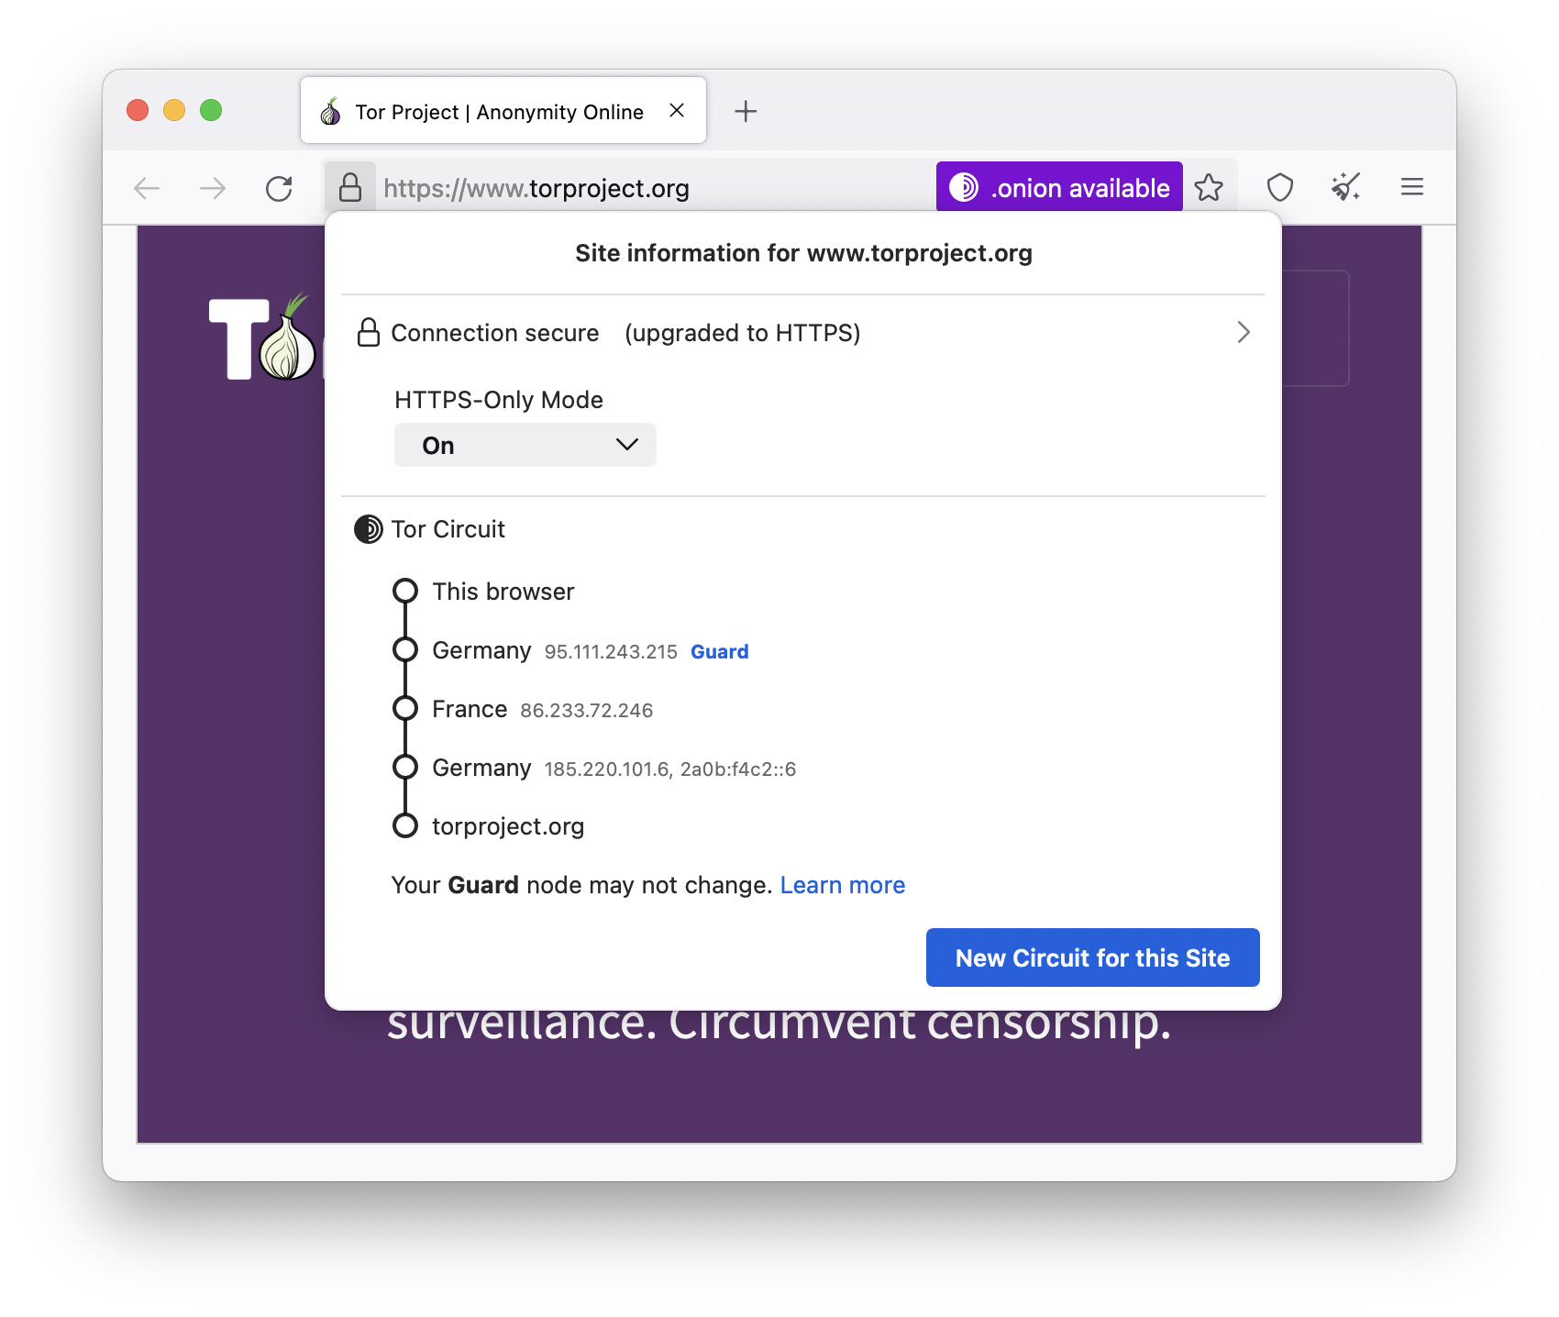
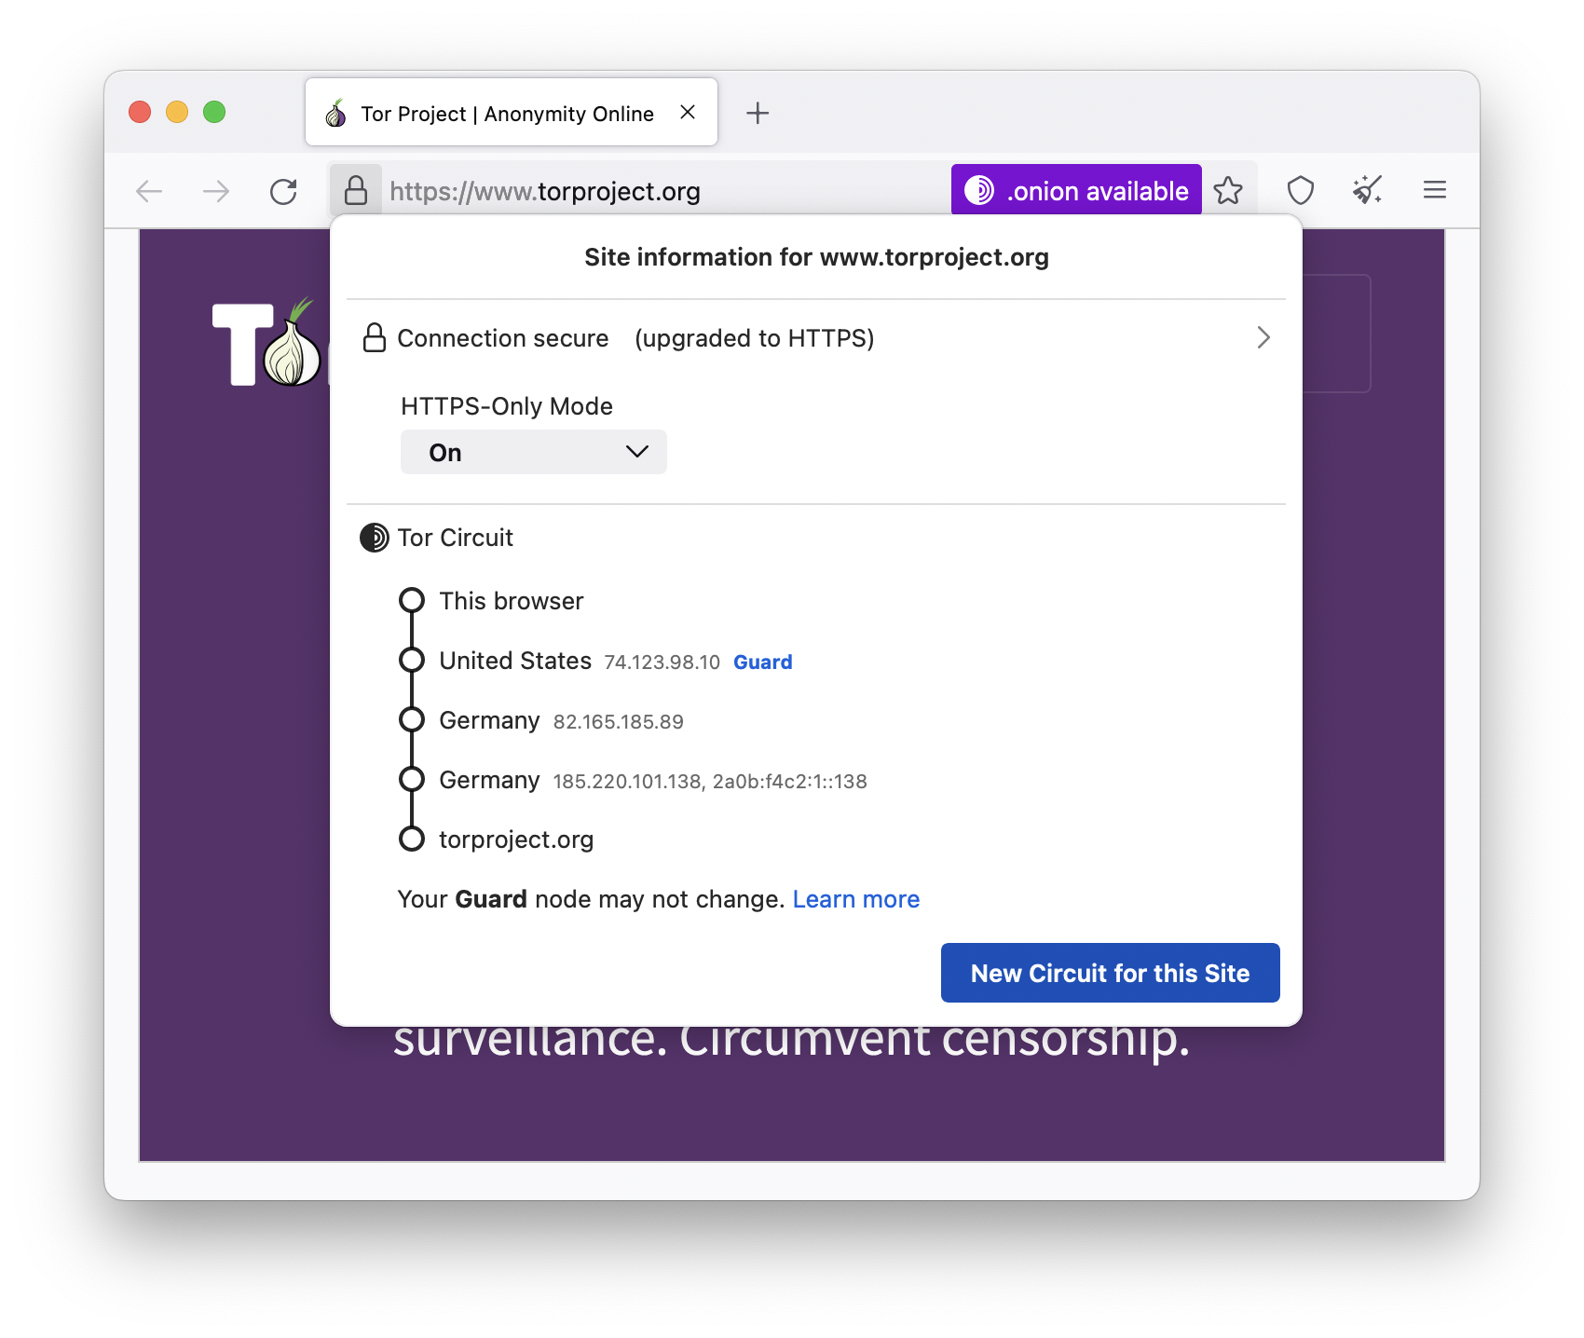
Clicking on the padlock will show your current Tor circuit (and “New Circuit for this Site” option)

Slide 94

Updating Tor Browser
Every update brings new features and resolves security vulnerabilities.

Slide 95
Uninstalling Tor Browser
Uninstalling Tor Browser is as easy as moving the folder to the trash! Then, emptying the trash.
Default Tor Browser folder locations:
Windows: Desktop
Linux: home, or look for a name like “tor-browser_en-US”
MacOS: Move the Tor Browser application to Trash and also the TorBrowser-Data folder (~/Library/Application Support/)

Slide 96
Troubleshooting Tor Browser
Is your system clock correct?
Is the browser already running?
Are you being censored?
Is your antivirus or firewall blocking Tor?
Do you have a very old operating system?
Try uninstalling and reinstalling
Get help at https://support.torproject.org

Slide 97
What to do when Tor is blocked

Slide 98
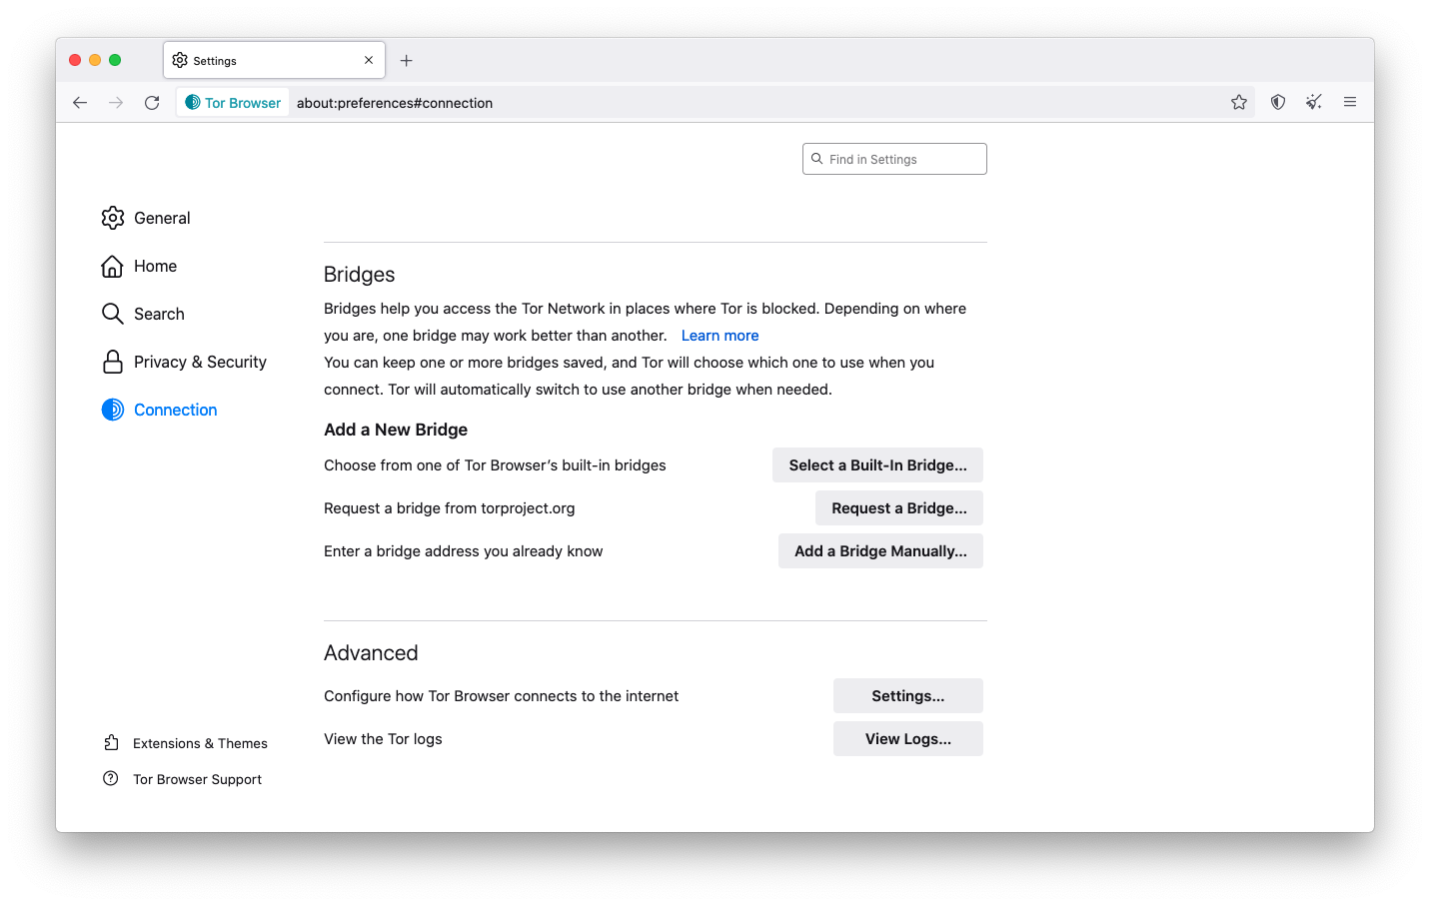
When the connection to Tor is censored
Direct access to Tor may be blocked by some Internet Service Providers and governments.
Tor Browser includes circumvention tools for getting around these blocks called bridges.
Bridges are relays that are private and harder to block.

Slide 99
Meet “Connection Assist”
Connection Assist is a new feature for users burdened by censorship.
When Tor is blocked, Connection Assist will offer to automatically apply bridge configurations that might work best in a user’s location.
Users can still configure settings manually!

Slide 100
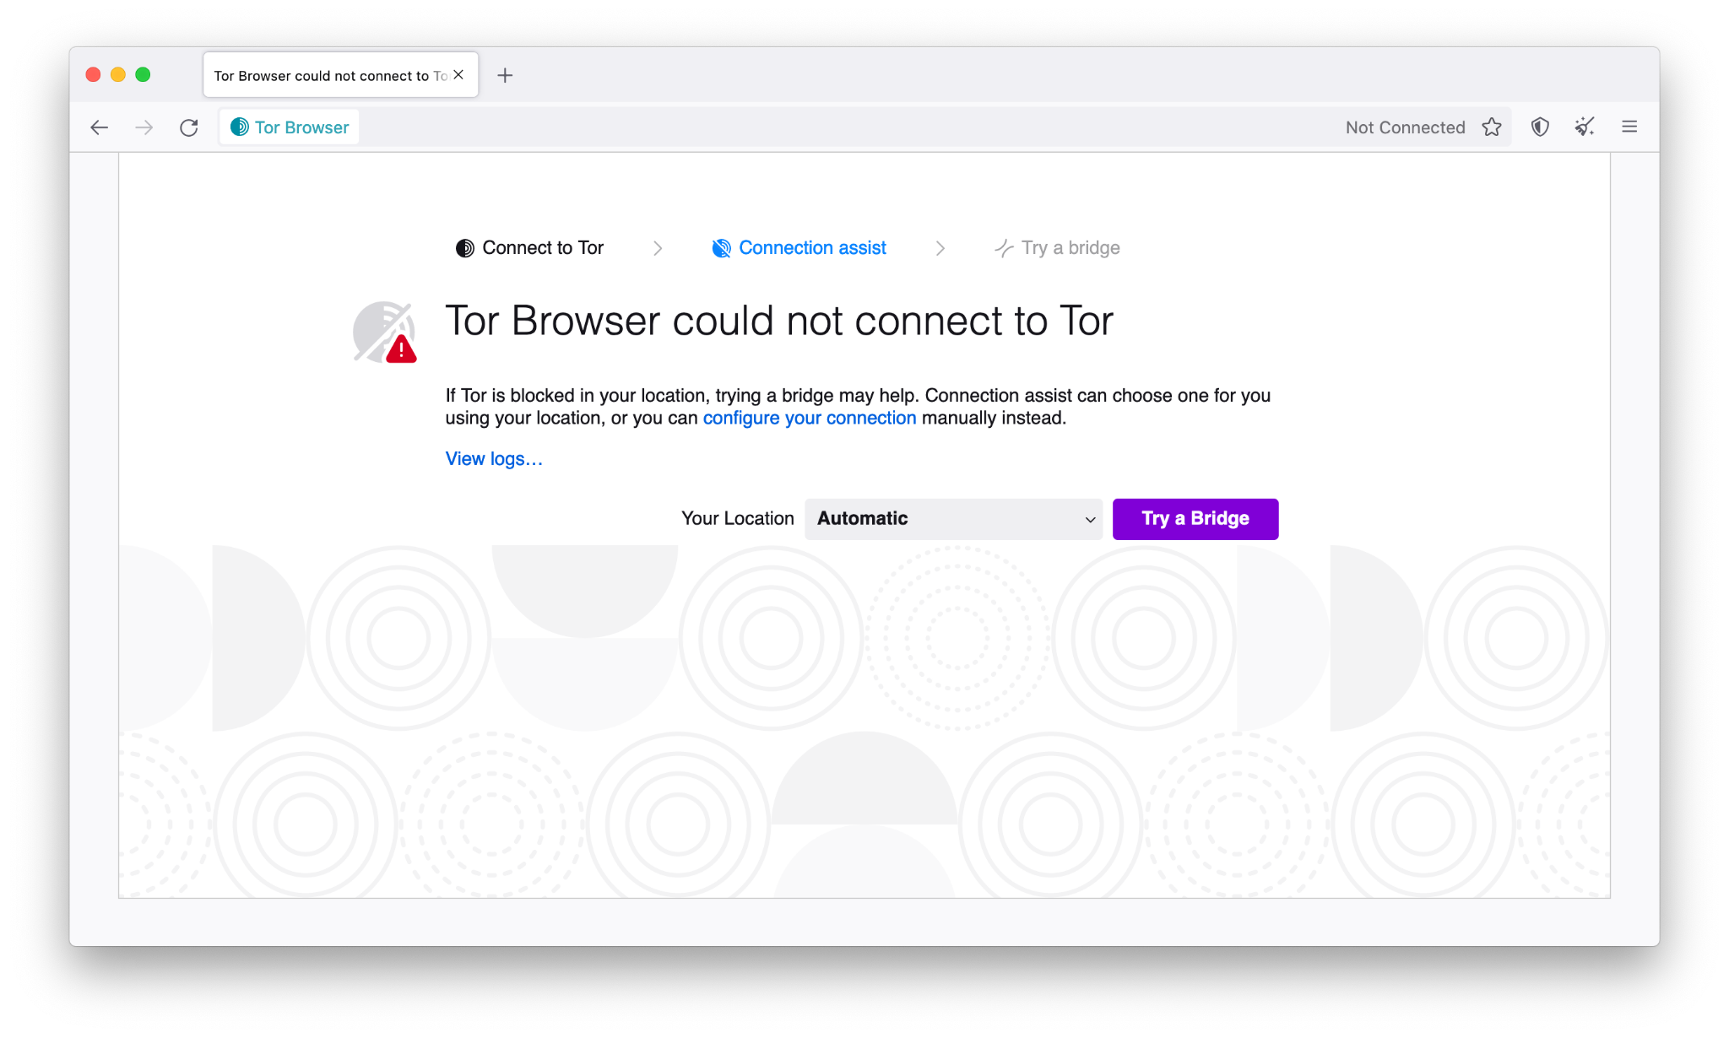
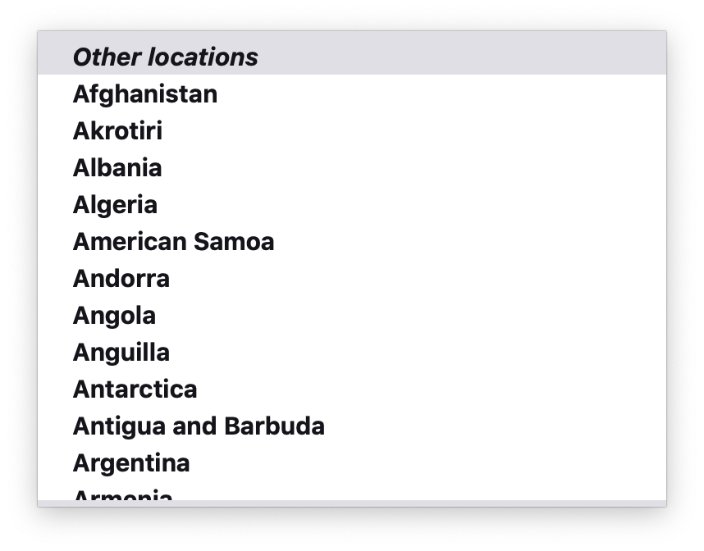
“Connection Assist” helps users configure bridges

Slide 101
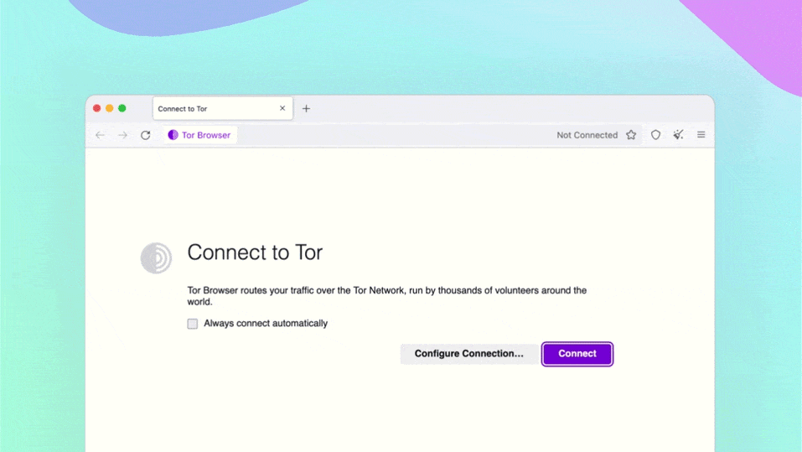

Slide 102
Configuring bridges manually
You can get bridges from:
Tor Browser: “Select a Built-In Bridge” on Tor Browser
Tor website: https://bridges.torproject.org
From a trusted source:
Telegram: https://t.me/getbridgesbot
By sending an email to bridges@torproject.org from Gmail or Riseup

Slide 103
Pluggable transports
Pluggable transports can be used like bridges to disguise Tor traffic (also called “built-in bridges”). Main types of pluggable transports:
obfs4: makes Tor traffic look random; works in many situations (if not, try meek-azure).
meek-azure: makes it look like Microsoft traffic; works in China.
snowflake: proxies traffic through temporary proxies using WebRTC. See: https://snowflake.torproject.org.

Slide 104
Snowflake
Snowflake helps you avoid being noticed by Internet censors by making your Internet activity appear as though you're using the Internet for a regular video or voice call.
Unlike VPNs, you do not need to install a separate application to connect to a Snowflake proxy and bypass censorship.
It is usually a circumvention feature embedded within existing apps: Tor Browser, Onion Browser, and Orbot.

Slide 105
Bridges and pluggable transports

Slide 106
Bridges and pluggable transports

Slide 107
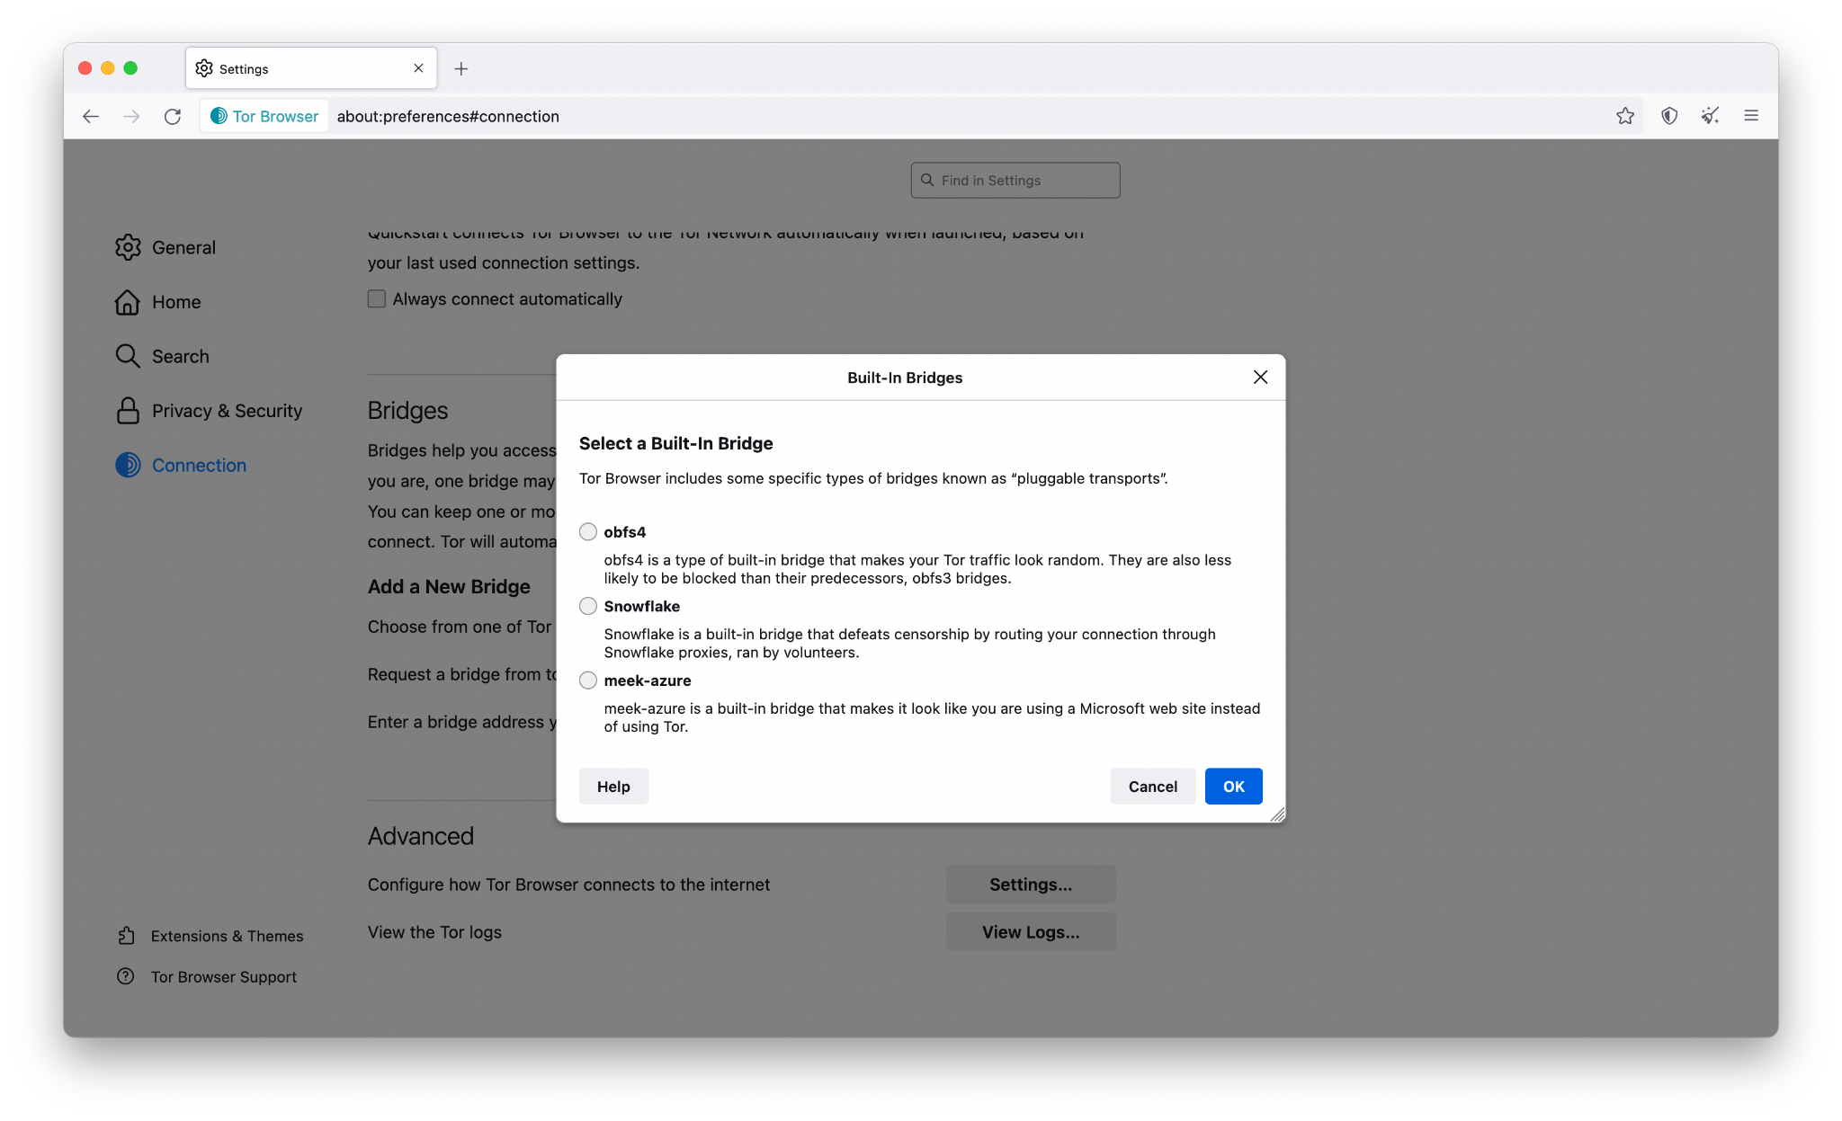
Choose a bridge from one of Tor’s built-in bridges

Slide 108
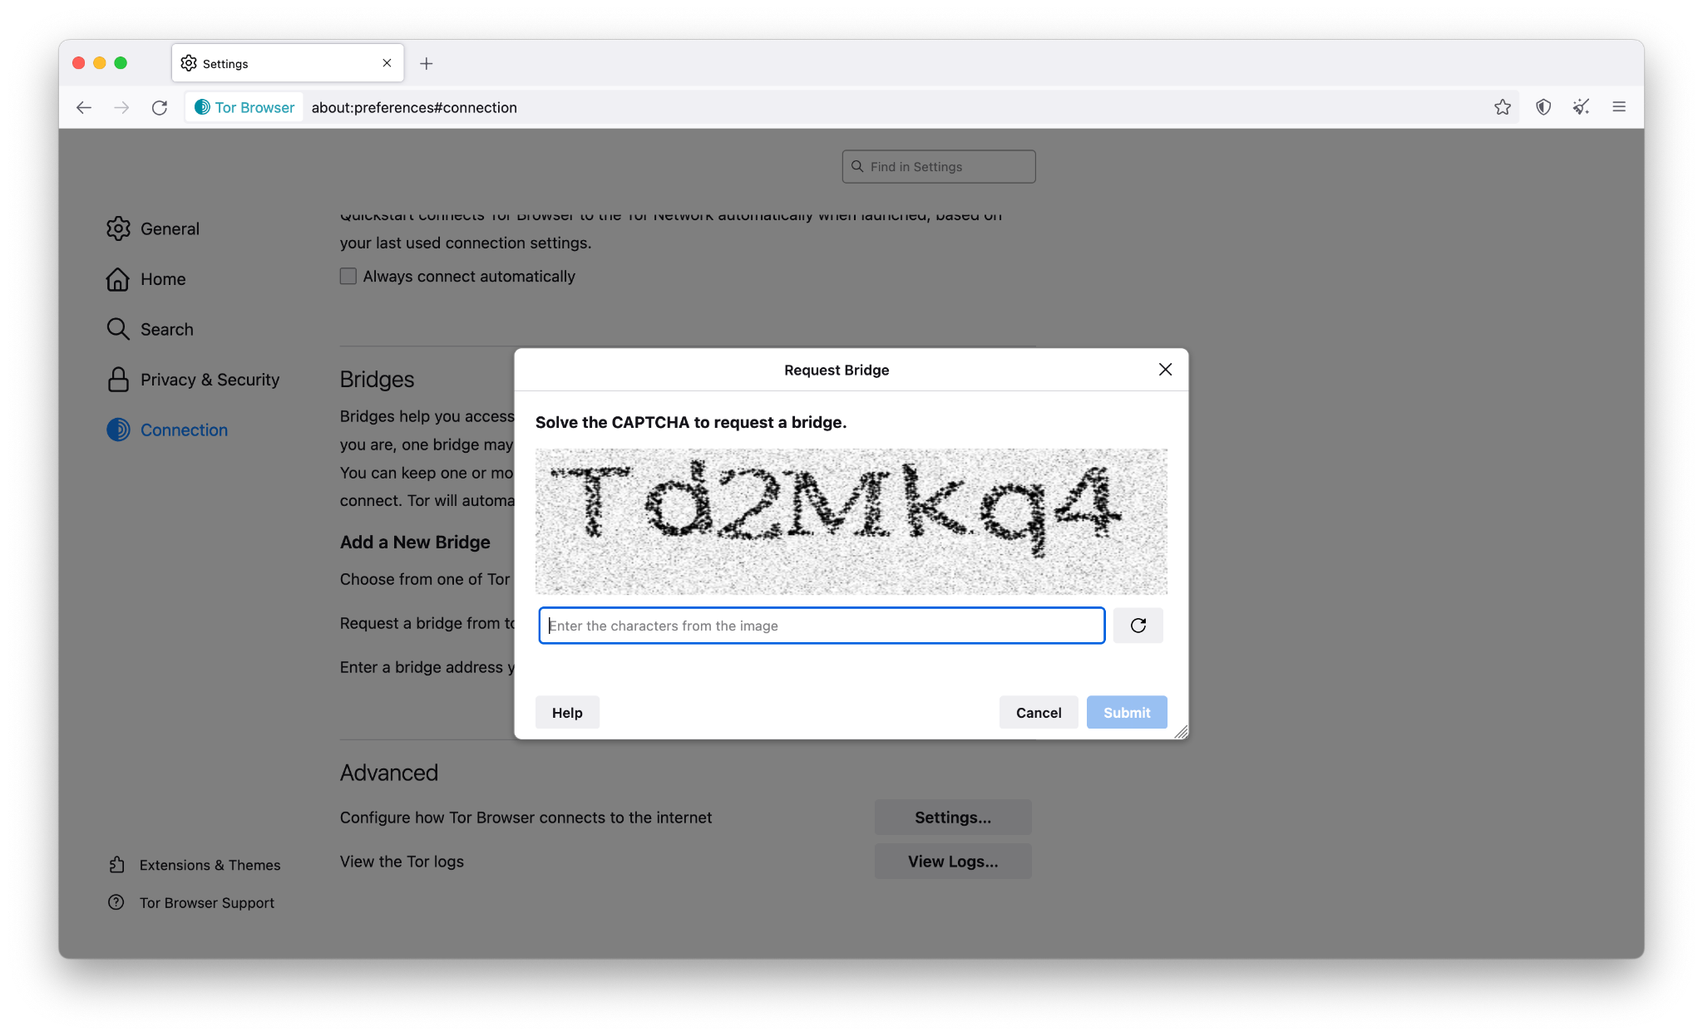
Request a bridge from torproject.org

Slide 109
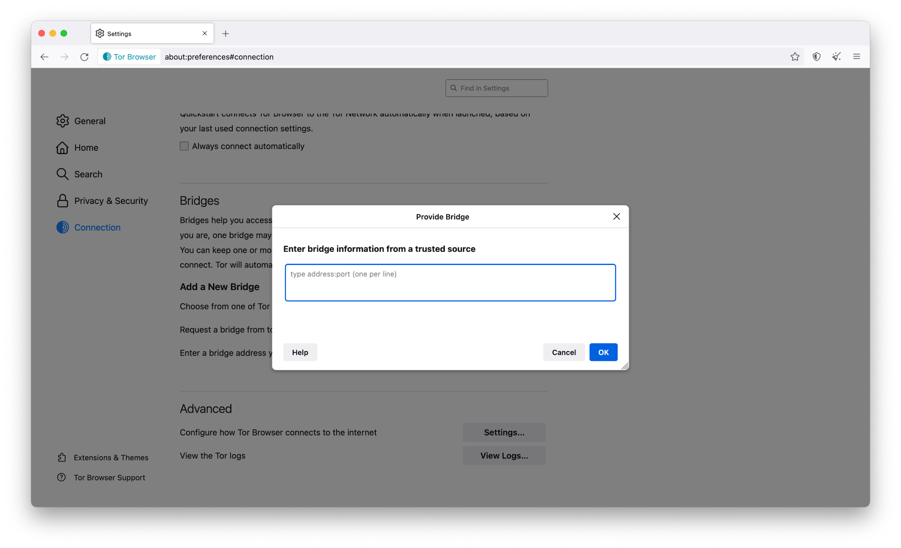
Enter a bridge address you already know

Slide 110
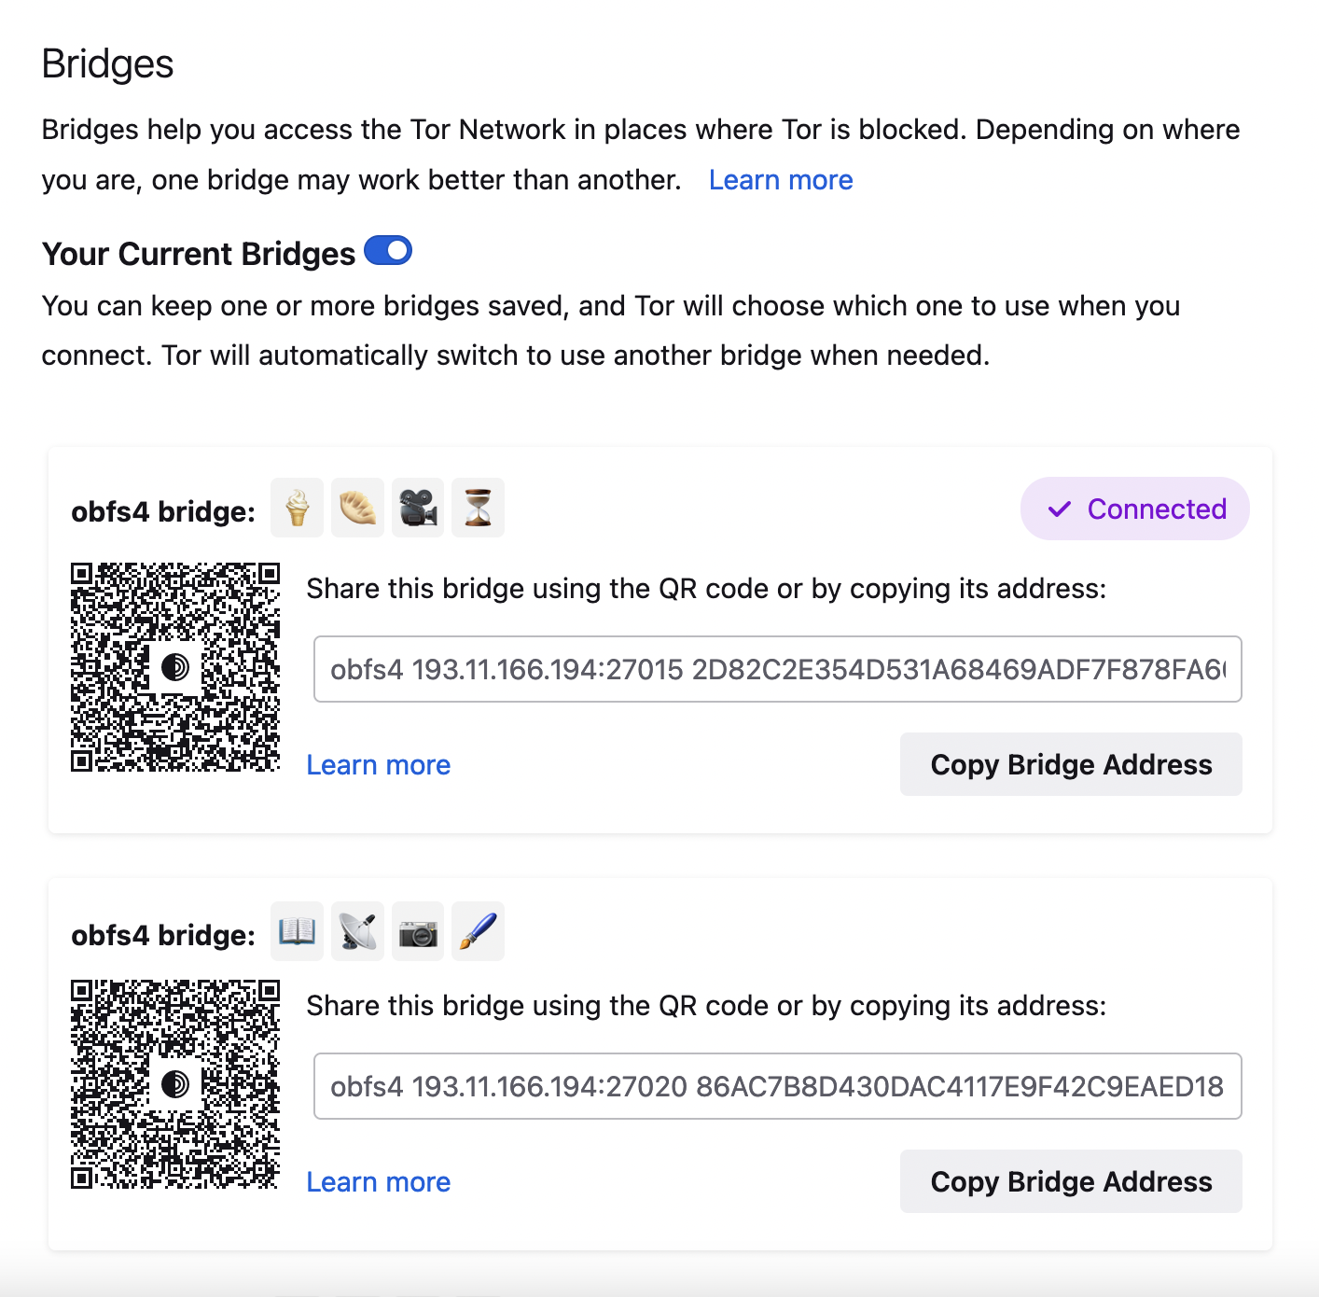
Bridge cards
Saved bridges appear in a handy stack of bridge cards including new options for sharing bridges too.

Slide 111
Open Observatory of Network Interference
Open Observatory of Network Interference: https://ooni.org/
Country-level reports of specific online censorship tools in use.
Explore aggregated reports: https://explorer.ooni.org/
Or use your own OONI Probe to measure Internet censorship: available in App Store and Google Play.

Slide 112
More Tor Browser

Slide 113


Slide 114

Connection Settings
Connection settings include connection statuses, censorship mitigation options, access to Tor log, etc.

Slide 115

HTTPS-only mode
HTTPS-Only Mode is enabled by default for desktop and HTTPS-Everywhere is no longer bundled with Tor Browser.

Slide 116

Security Slider
Recommended security level: safer or safest.

Slide 117

NoScript
Not advisable to change settings in the NoScript “options” menu.
Adding sites to the “whitelist” can result in fingerprinting.
Instead, “temporarily trust” blocked objects, or use security slider (Standard, Safer, Safest).

Slide 118

DuckDuckGo
DuckDuckGo is the default search engine in Tor Browser.
Using Tor Browser prevents DuckDuckGo from tracking users, even if they wanted to (they claim not to).
https://www.duckduckgo.com/ or https://duckduckgogg42xjoc72x3sjasowoarfbgcmvfimaftt6twagswzczad.onion/

Slide 119
Plugins, add-ons, JavaScript
Do not add any new add-ons/extensions to Tor, and don’t enable any plugins.
JavaScript is enabled by default, but is sanitized to preserve anonymity.
To prevent possible JavaScript vulnerabilities, use the “safest” setting in the security slider.

Slide 120
Mobile Tor: Tor-powered apps

Slide 121
Things to know about mobile Tor
The design of mobile devices makes full privacy impossible.
Mobile Tor is best for censorship prevention.
Can also provide better privacy for some threat models.
We’re making it better all the time and better options for mobile devices are coming out soon.

Slide 122

Tor Browser for Android
You don’t need to install two applications (Orbot and Orfox) anymore!
Find it in the Play Store or in the Guardian Project repository in F-Droid.
Or download .apk from: https://torproject.org/download/

Slide 123

Onion Browser for iOS
Onion Browser is the Tor Browser for iOS.
You can find it in the App Store.
Be careful: lots of fake Tor Browsers available for iOS!
Notes: app is rudimentary and tends to crash on sleep.

Slide 124


Orbot: Tor VPN
Orbot routes mobile apps’ traffic through Tor, you can select specifically which apps to run through Tor.
Orbot is available on iOS and Android.
Developed and maintained by the Guardian Project: https://orbot.app/

Slide 125

More on Orbot
Toggle “VPN mode” on main screen.
Then click “Orbot-enabled apps”.
Then select the apps you want to proxy with Tor.
You can also choose your exit country if you want (but note that some countries don’t have exits relays).
Image source: Guardian Project

Slide 126
What are Onion Services?

Slide 127
The regular internet allows adversaries to see what you are sharing and with whom, whether you're using Dropbox etc, downloading it from email or through your browser...
...so Tor devised a sneaky way to hide both the file data and the related metadata!

Slide 128

Onion Services are online services that are only available through the Tor network.
An Onion Service connects to a rendez-vous node/relay inside the Tor network; and the user wanting to connect to it does the same.
As a user, you never leave the Tor network when visiting an Onion Service.
Onion Services provide end-to-end encryption: both visitor and website use Tor (without HTTPS).

Slide 129
OnionShare
Secure, private, anonymous file sharing done easy, built on top of the Tor network.
Uses onion services to securely send files.
Creates an onion service where the file can be downloaded.
No need to trust third parties like Dropbox.
All communication happens on the Tor network.
Download from: https://onionshare.org/

Slide 130

Step 1: Download OnionShare
Available on: Windows, macOS, Linux.
Download: https://onionshare.org/

Slide 131

Step 2: Select “Share Files”
In the “Share Files” section, click “Start Sharing”.
Your contacts only need to have Tor Browser installed.
Notes:
Suggested: https://html5up.net/

Slide 132

Step 3: Upload your file
Drag and drop the file into the folder into the section.
Notes:
Suggested: https://html5up.net/

Slide 133

Step 4: Share your file
Once the file is added, click on “start sharing”
Tip: To allow downloading more than once, e.g. for you group, uncheck the first box.
Notes:
Suggested: https://html5up.net/

Slide 134

Step 5: Copy and share the address and key
Copy the address and share it with the intended recipient (e.g. via email).
Copy the private key and share it to the same recipient, preferably through a different channel (e.g. via instant messaging).
Notes:
Suggested: https://html5up.net/

Slide 135

Step 6: Download through Tor Browser
The recipient can download the file through Tor Browser by entering the address and key in the URL bar.
Tip: you must keep your OnionShare window on your device open as long as you want people to download your file.
Notes:
Suggested: https://html5up.net/

Slide 136

Step 7: Check download progress
When they finish downloading, you’ll see a notification alert in OnionShare’s history.
Notes:
Suggested: https://html5up.net/

